Slide 1
Welcome to FESSH !

Slide 2
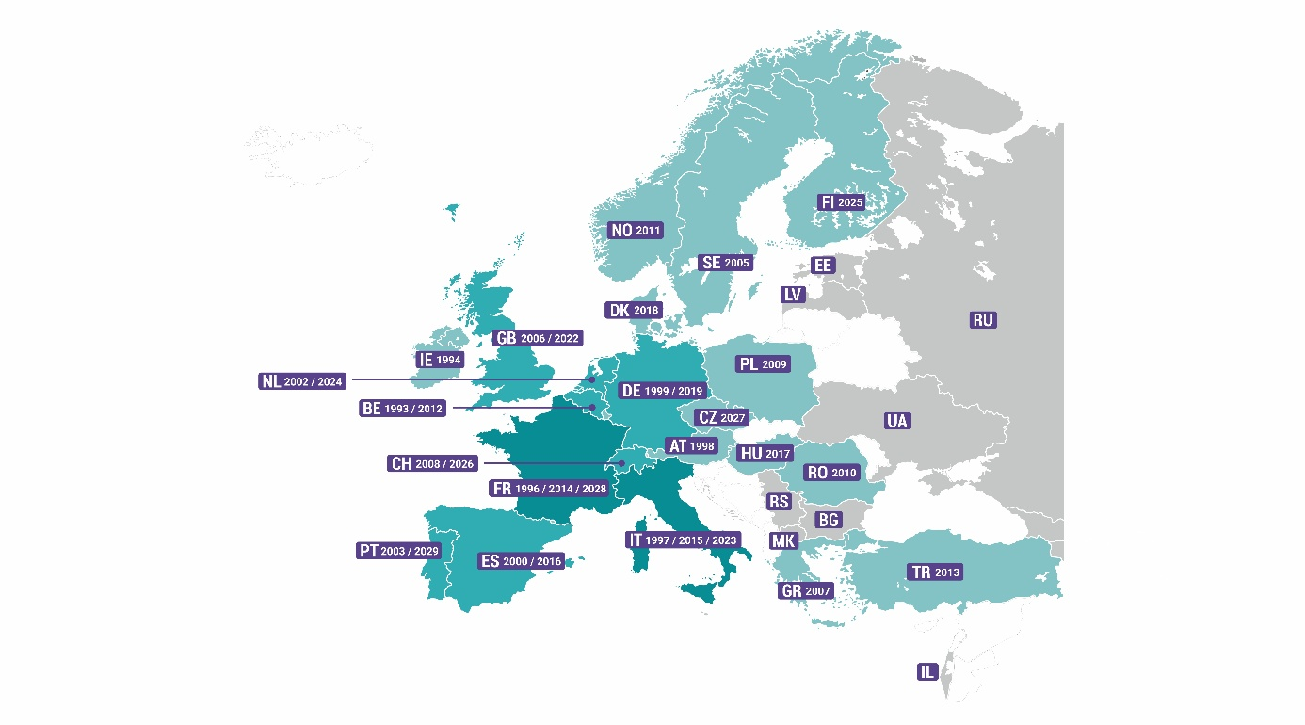
WHAT IS FESSH?
FESSH = Federation of European
Societies for Surgery of the Hand
If you are member of your national society - then you are also member of FESSH!
(Grey and green coloured countries are the FESSH members, the white ones are non-FESSH members.
The green ones hosted a FESSH congress, the grey ones not yet. The numbers refer to the date when the national societies organized a FESSH Congress.)

Slide 3
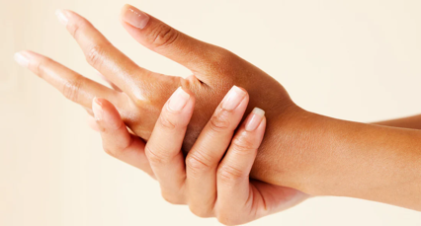
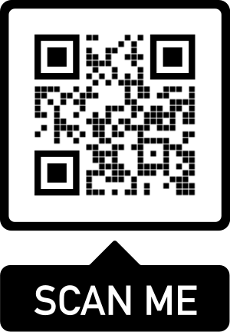
WHAT DOES FESSH DO? www.fessh.com
OUR MISSION:
The advancement of hand surgery in all aspects, encompassing science, education, and clinical practice.
OUR VISION:
To become the authority in the field of hand surgery in Europe. This includes all relevant parties: hand surgeons, allied health professionals, patient representatives, industry partners, representatives from the public, and government bodies.

Slide 4

And now comes the interesting part…
Notes:
I understand, this sounds quite boring but it is not because FESSH has a lot to offer which I will show on the next slides

Slide 5
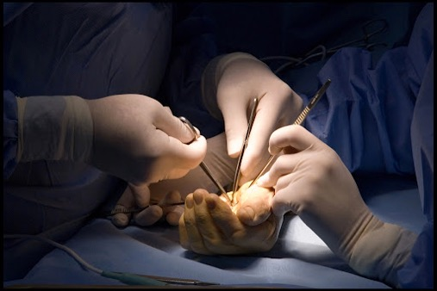
WHAT BENEFITS DOES FESSH OFFER YOU?
EDUCATION AND TRAINING
RESEARCH
Special interest groups (SIGs)
CLINICAL PRACTICE
ANNUAL CONGRESS
BEING PART OF A FANTASTIC COMMUNITY

Slide 6
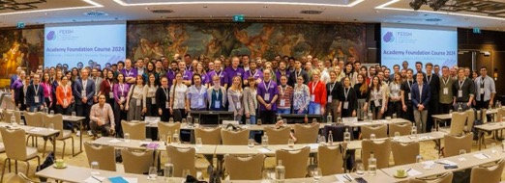
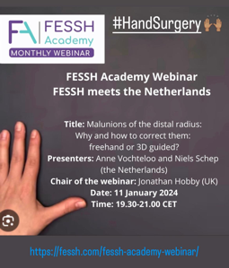


EDUCATION AND TRAINING
FESSH Academy Foundation Course (discounted price)
FESSH Academy Advanced Course (discounted price)
FESSH Academy Webinars (free)
Support for international hand related courses
FESSH Travel Award (1500-4000€ for visiting a European hand clinic)
Annual Congress Fellowships (14 day study tour financed by FESSH)
Annual Congress Educational Afternoon
E-LIBRARY at the webpage
FESSH Youtube channel
Find TRAINING CENTRES through FESSH

Slide 7
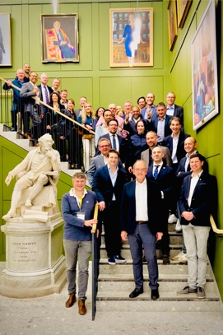
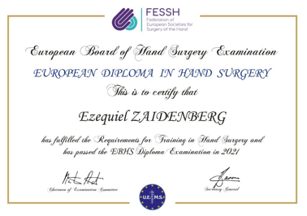

EUROPEAN BOARD HAND SURGERY DIPLOMA
Internationally recognised qualification in Hand Surgery running since 1996.
Try the Online Self-Assessment on FESSH webpage
Take the EBHS Exam
Join the board of examiners
YOUR NAME HERE!

Slide 8

RESEARCH
Basic Research Grant €10.000
Clinical Research Grant €10.000
PROMS Grants €5.000
Shark Tank Award total €20.000 (for innovative ideas)
Research Fellowship (one week visit in a research center financed by FESSH)
FESSH patronized surveys

Slide 9
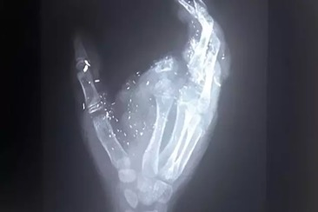

CLINICAL PRACTICE
HAND TRAUMA NETWORK
(FESSH accreditation for your clinic)
GREEN / SUSTAINABLE HAND SURGERY
(guidence, network)

Slide 10

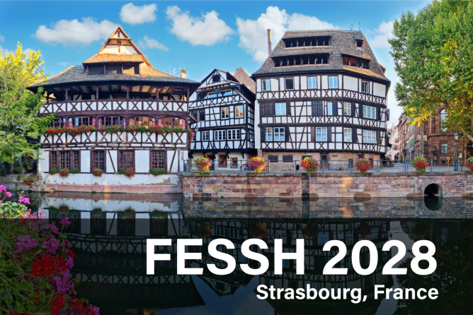
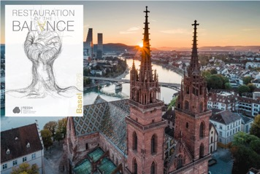

ANNUAL CONGRESS
Join 2000+ colleagues from Europe and across the globe
2026 Basel
2027 Prague
2028 Strasbourg
2029 Porto
2030 Your city?

Slide 11
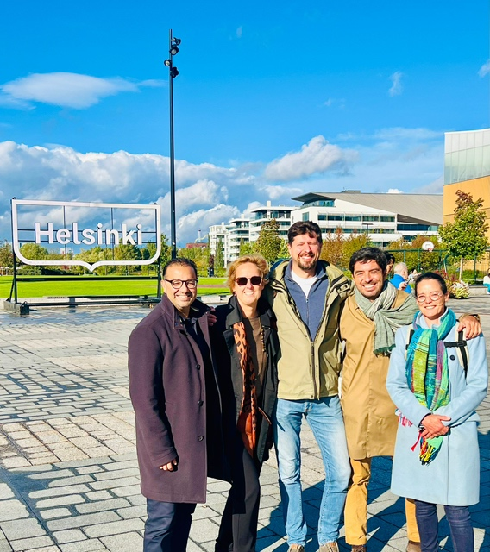
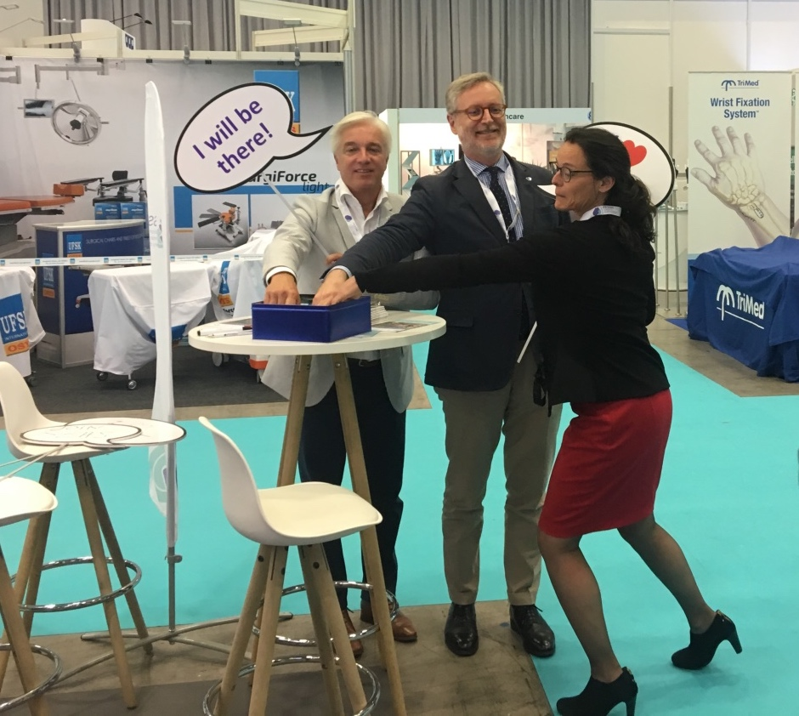
BEING PART OF A FANTASTIC GROUP!

Slide 12
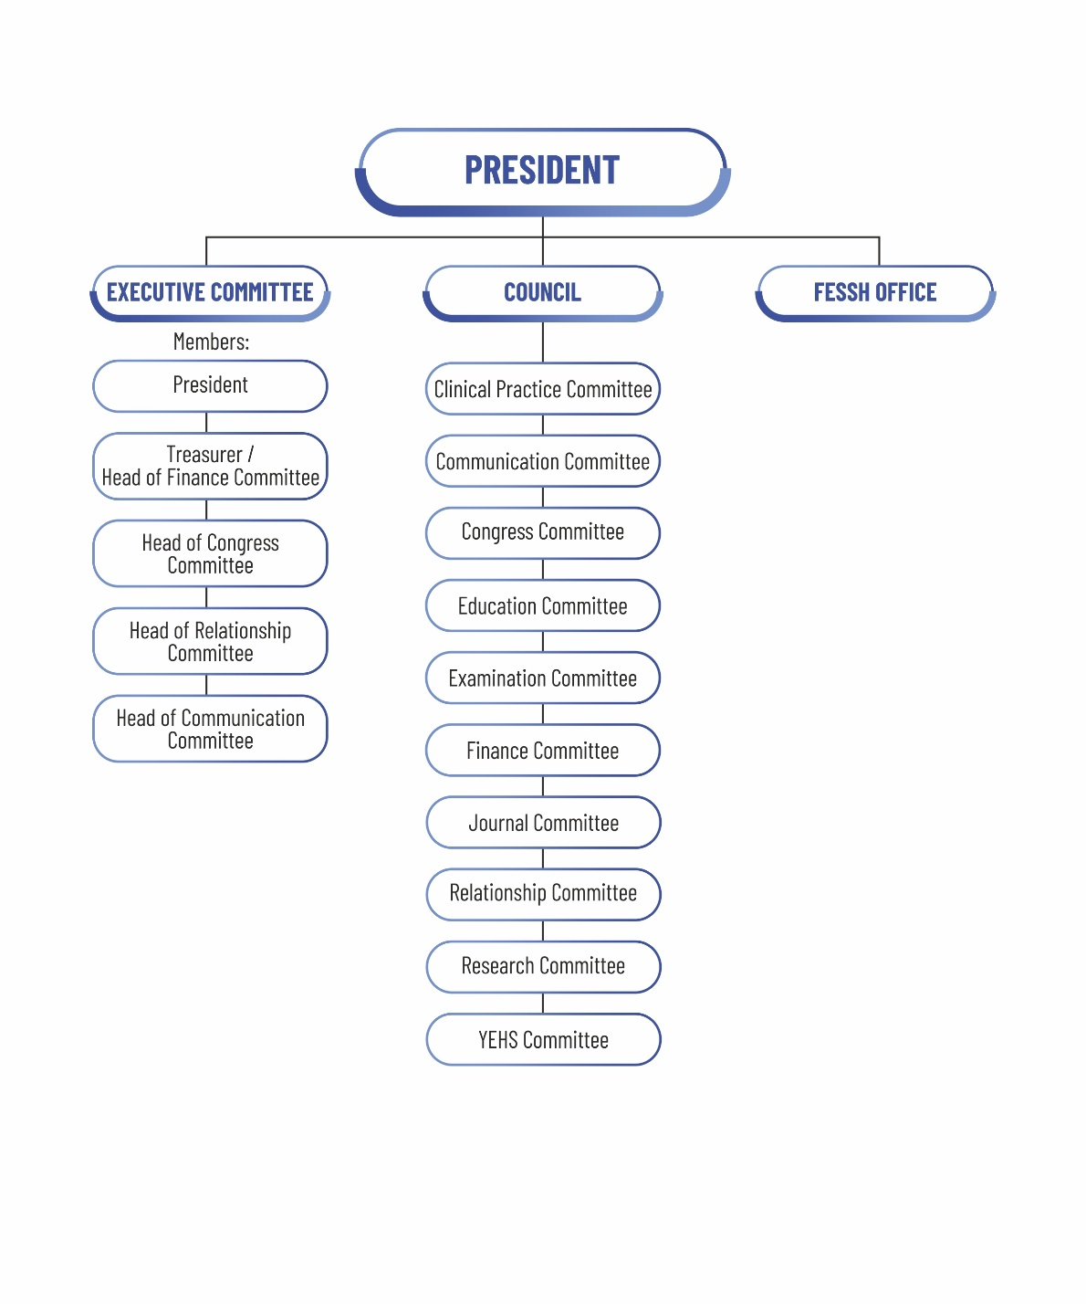
WHAT IS THE STRUCTURE OF FESSH?
President (Secretary General before)
Executive Committee
FESSH Council
FESSH Office

Slide 13
HOW CAN I GET INVOLVED IN FESSH?
You can access all aspects of FESSH! https://fessh.com/how-to-get-involved/
Meet us in the
annual Congress
ATTEND OUR COURSES
GRANTS, AWARDS, FELLOWSHIPS
Subscribe to the FESSH Hand Out
BECOME AN EXAMINER
CHAIR A CONGRESS SESSION
JOIN A FESSH COMMITTEE
FOLLOW THE YEHS news
BECOME A JOURNAL REVIEWER OR EDITOR
JOIN A FESSH SIG:
3D, Microsurgery, Prevention, Dupuytren,
Pediatric, Spasticity, Dynamic Imaging Groups
GET ACCREDITATION FOR YOUR TRAUMA UNIT
FOLLOW US ON SOCIAL MEDIA

Slide 14

HOW CAN I GET IN CONTACT WITH FESSH?
Contact your national society FESSH delegate: fessh.com/national-delegates/
Or the FESSH Office - office@fessh.com
Visit our website www.fessh.com
Follow us on social media:
Instagram, X, FaceBook, Linked In
Watch the FESSH Youtube channel
Subscribe to the monthly FESSH Hand Out (send a message to office@fessh.com)

Slide 15

Young Hand Surgeons
Networking
Important information source regarding what benefits FESSH can offer to young hand surgeons
education
research
training
https://fessh.com/yehs-young-european-hand-surgeons/
info@yehs.eu
Notes:
The YEHS is a separate group of young handsurgeons that reperesent the interests of trainees and the young handsurgeons, The YEHS collaborates with the FESSH intensively and the president of YEHS is a member of the council. I would like to advice you to become a member of the YEHS.
As shown, FESSH has a lot offer for all handsuregons but especially for the young ones because they are the future. All kind of activities and support are provided in the three main pilars as explained on the former slides. Furthermore, there are three opportunities to visit other clinics and meet and learn from experts: first as a fellow in a traning center, some will pay for the fellowship, Another way is by applying for a travel award or the congress fellowship. You can find the infomation on the website.

Slide 16
What FESSH means to you?
Tell us ”What FESSH means to you” and win a free registration to the next congress!
Save your short film (no more than 90 seconds) on any online platform (e.g. Google drive) and send the link to office@fessh.com within a week following your national congress.
Your video could be about anything you would like to say about your experience and what you like about FESSH.

Slide 17

JOIN the FESSH activities Together we make a difference
Notes:
Thank you and hopefully we see each other soon in Rotterdam

