Slide 1
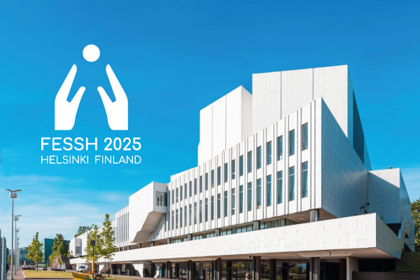

FESSH Research Fellowship
16-24 June 2025, Turku, Finland
Dimitris Challoumas

Slide 2

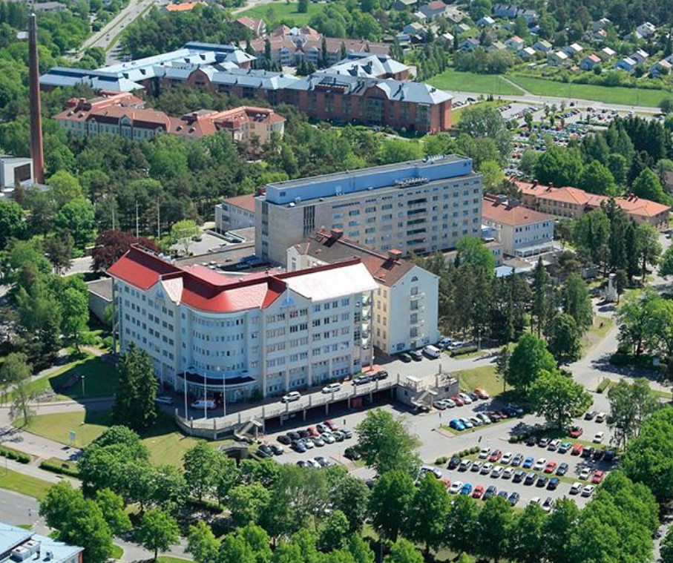

Research/Clinical Activities

Slide 3
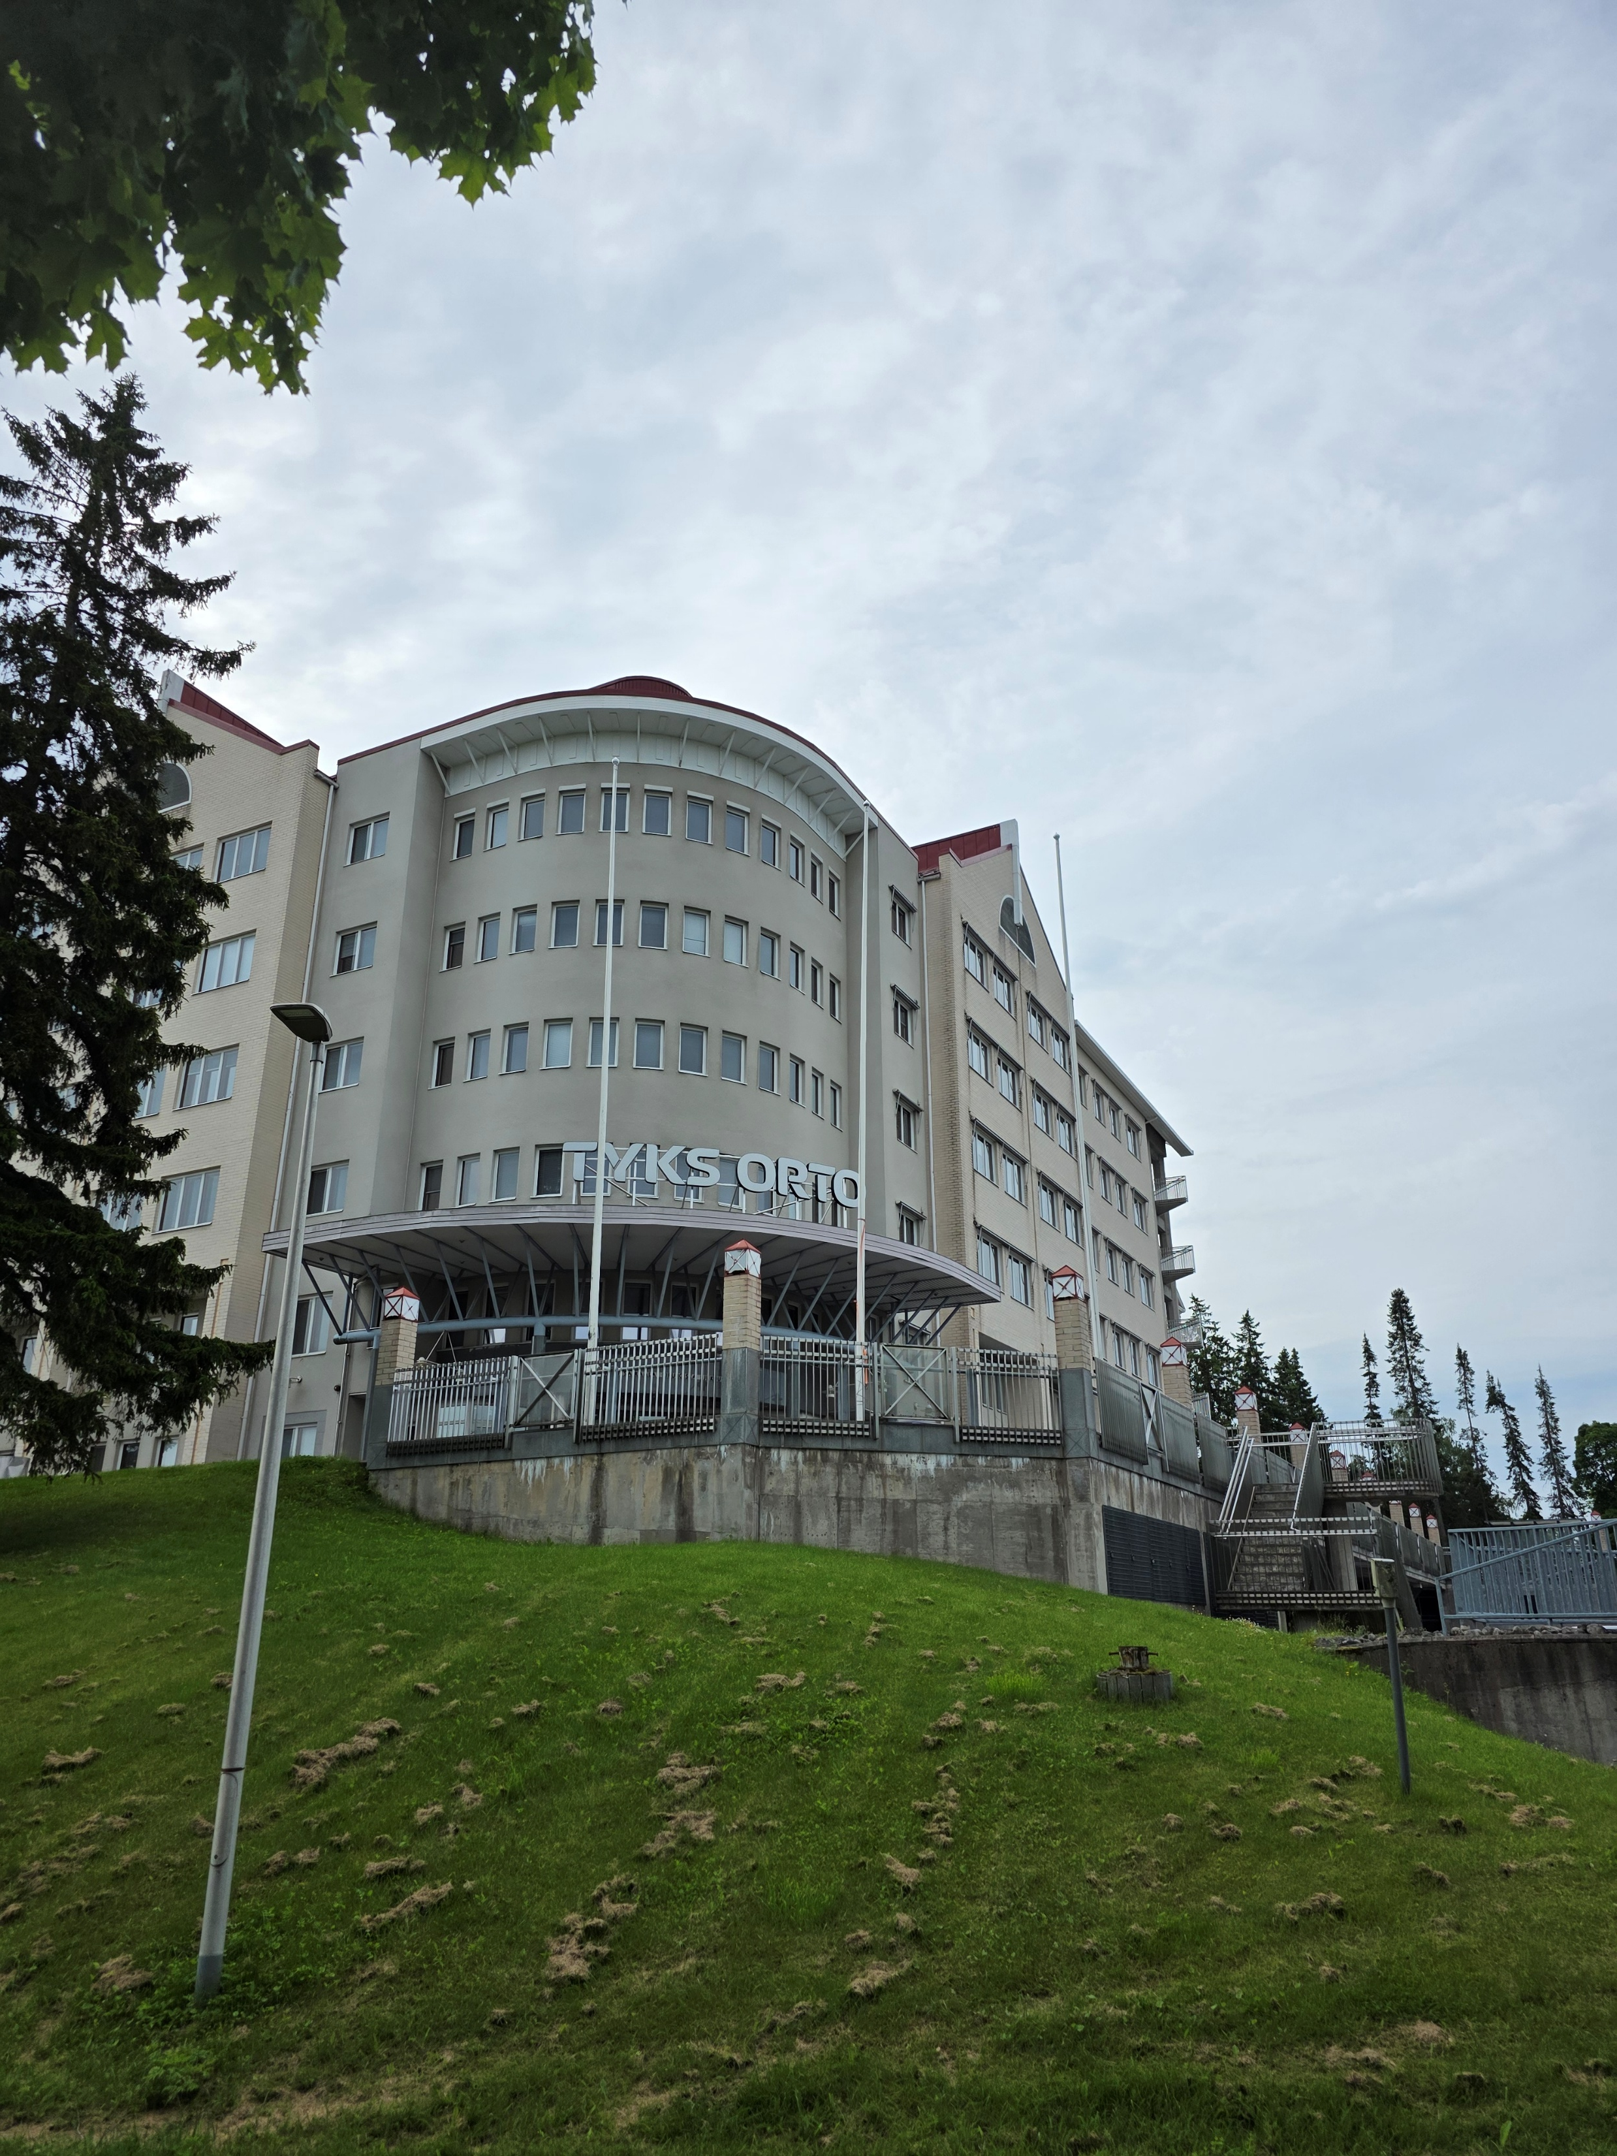
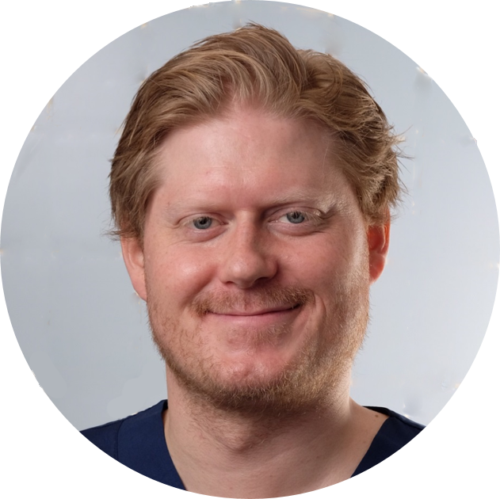
Markus Pääkkönen

Slide 4
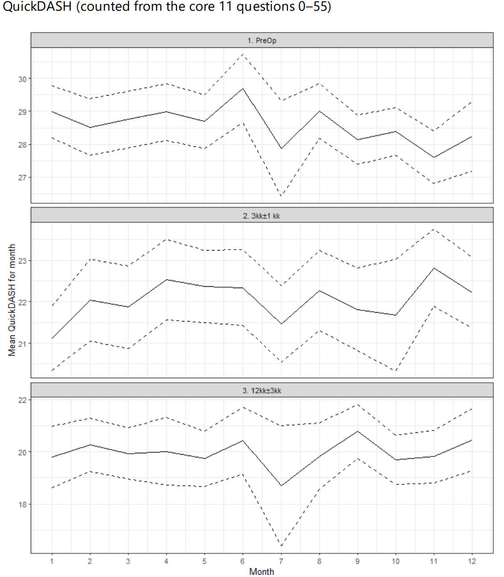
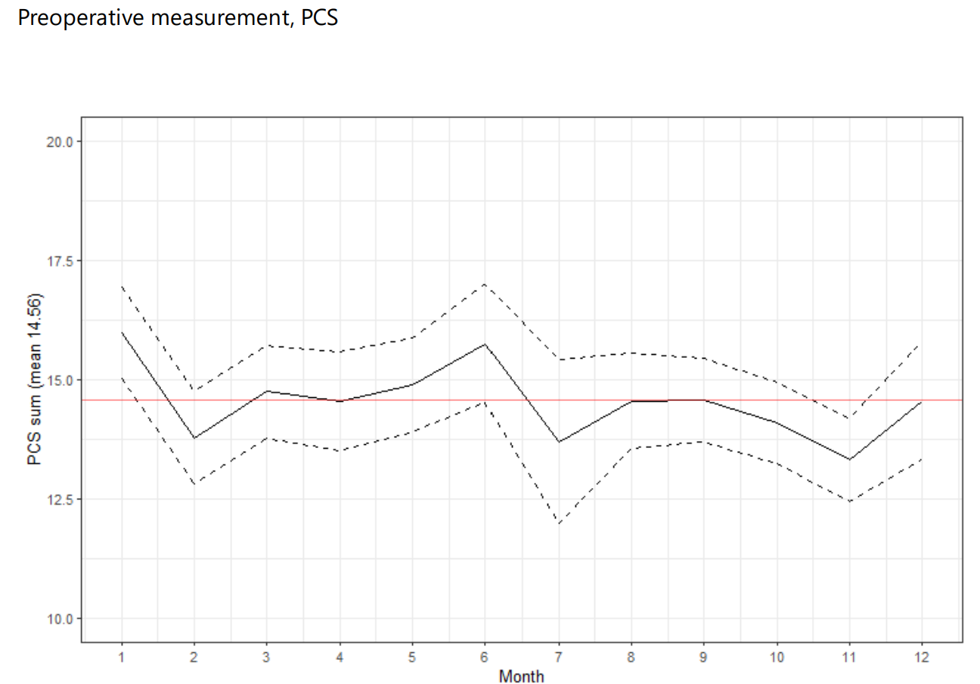
Seasonal variations in Carpal Tunnel Syndrome

Slide 5

Seasonal variations in Carpal Tunnel Syndrome
Research Questions
Is there seasonal variation in the frequency of presentation of CTS?
Is CTS more/less disabling/symptomatic (QuickDASH) during specific times of the year?
Do patients with CTS catastrophise more/less during specific times of the year?
Is there a correlation between QuickDASH and pain catastrophising?
Does timing of CTR affect postop QuickDASH (summer vs winter)?

Slide 6
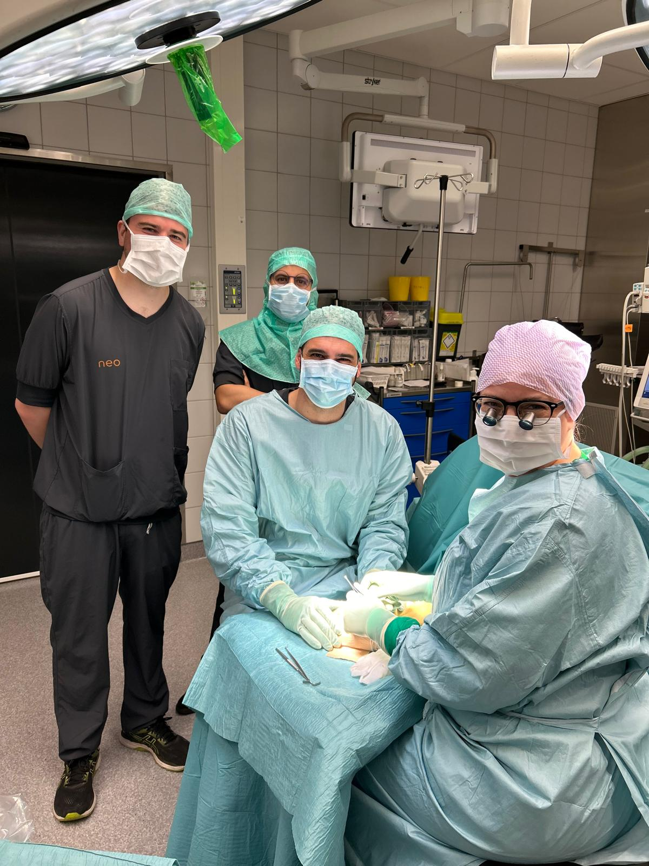
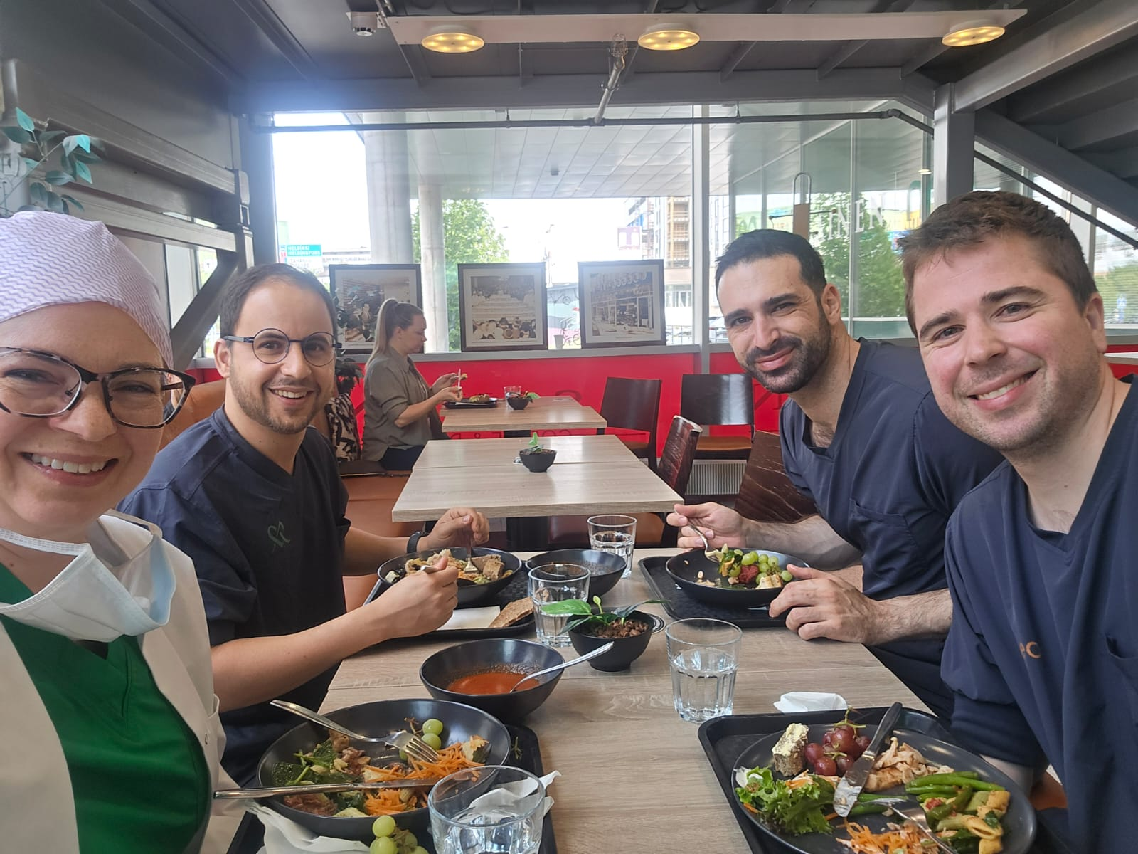
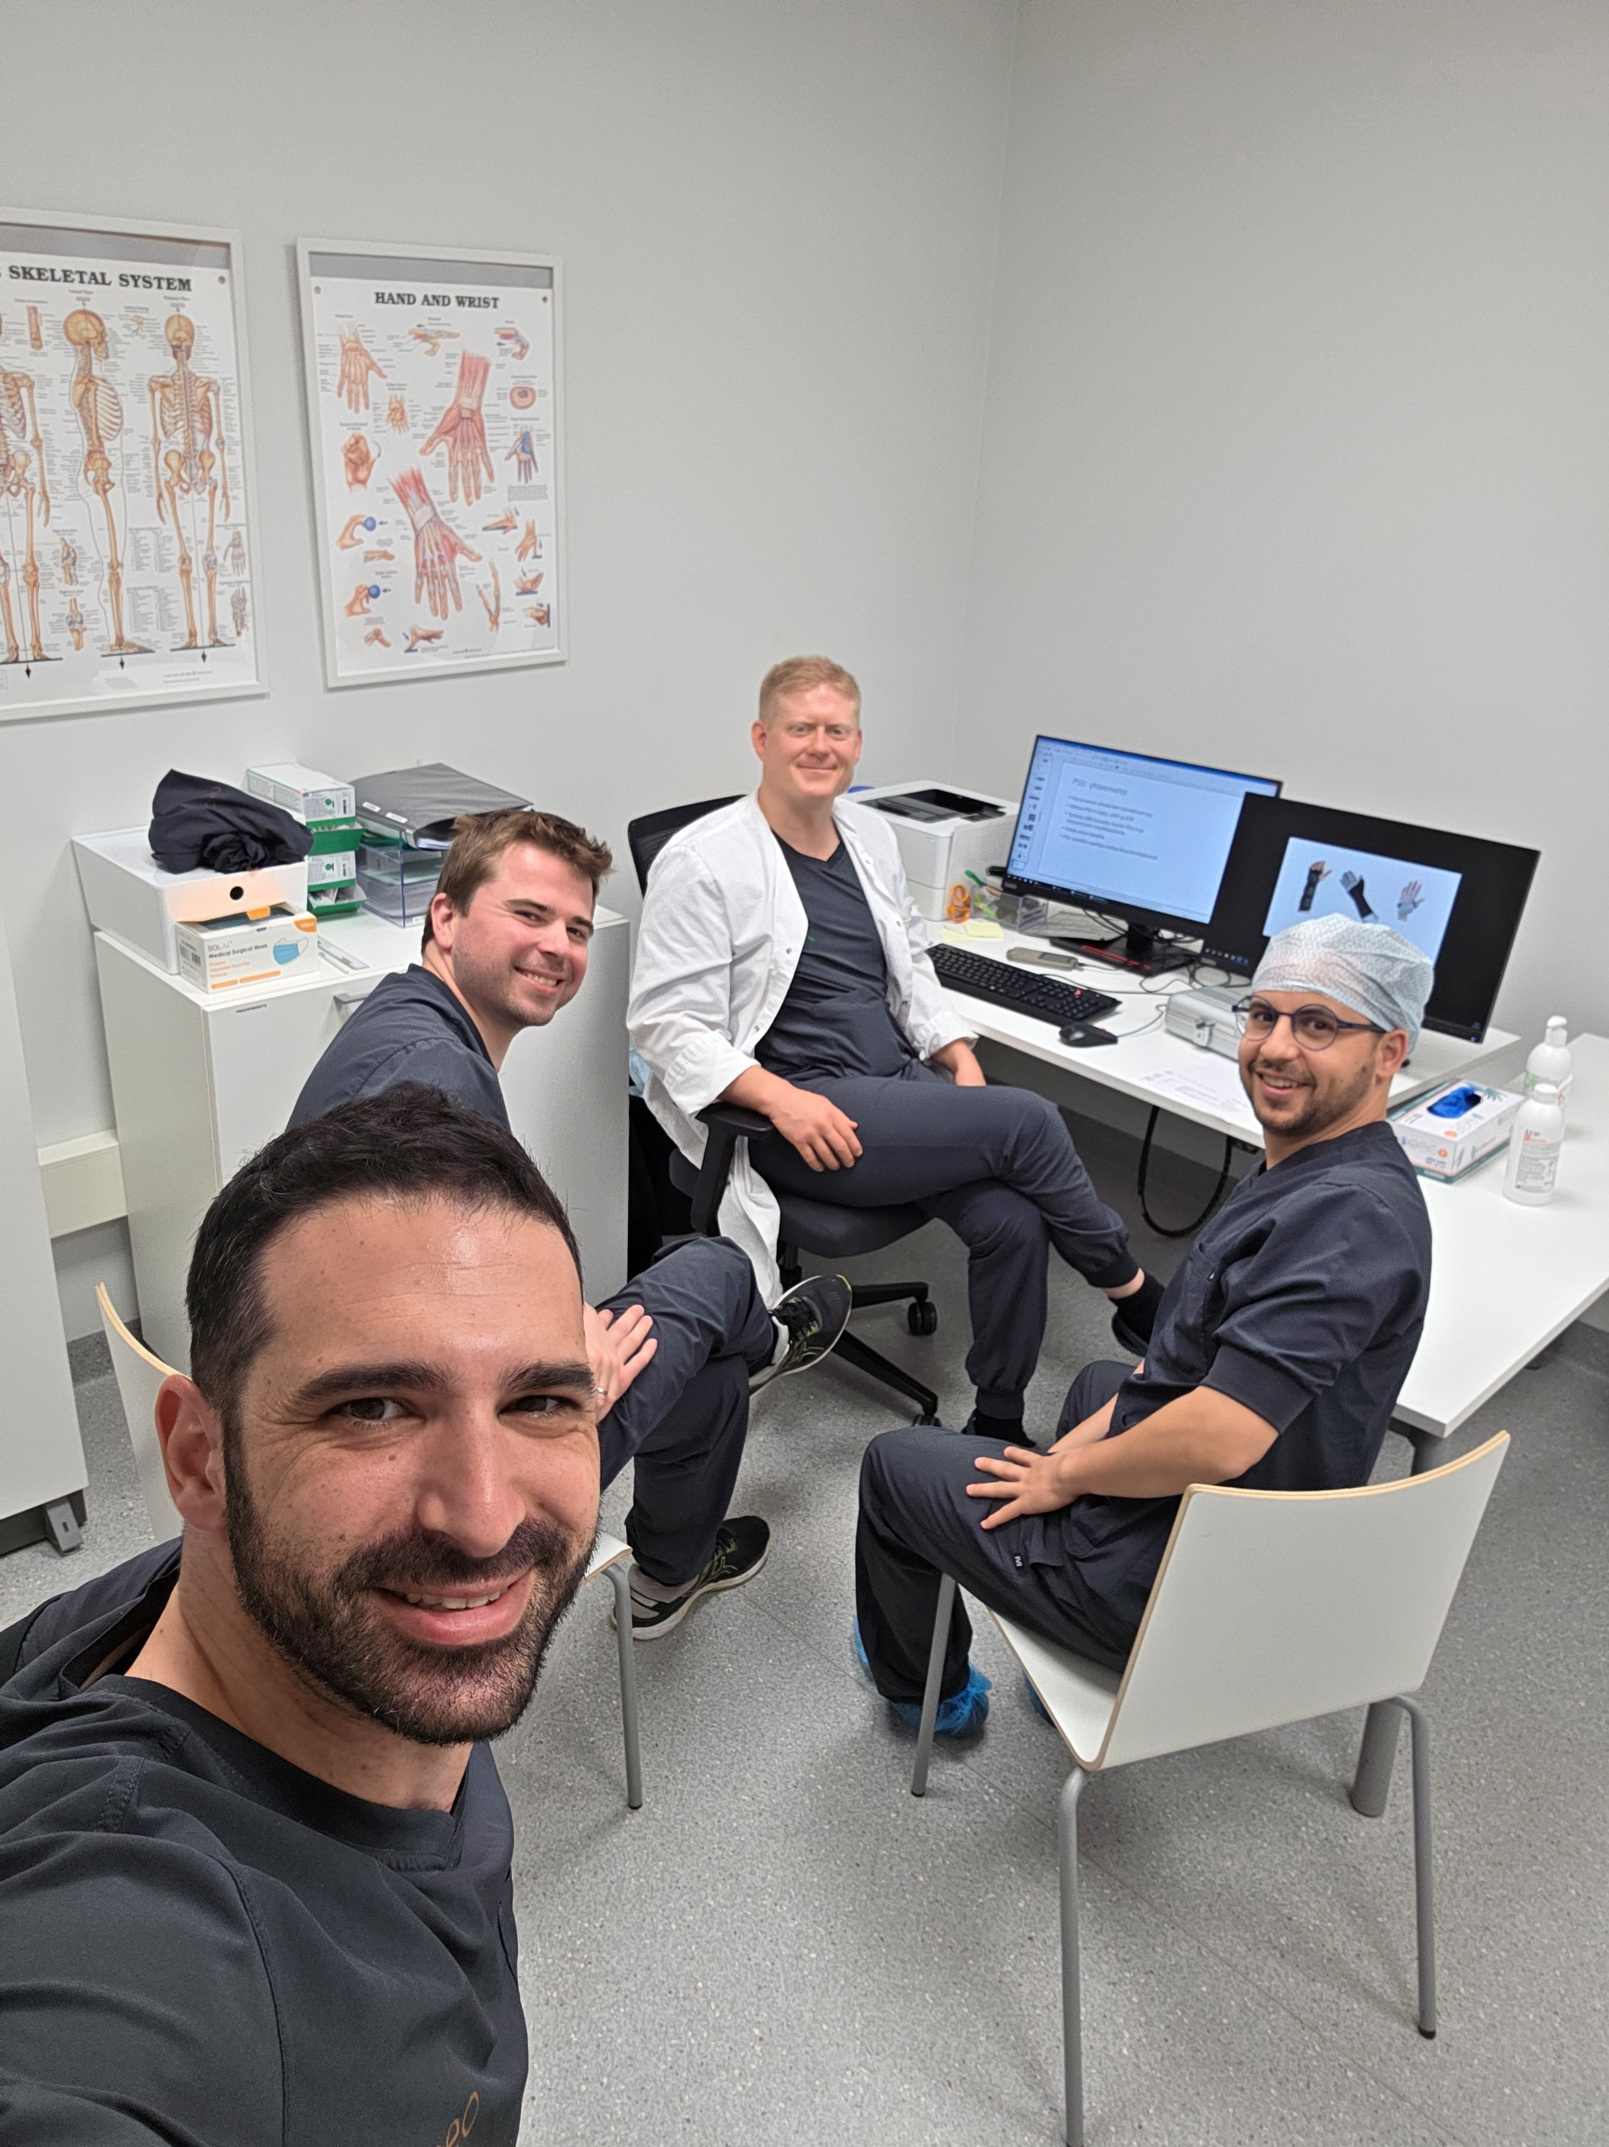
Neo Mehilainen

Slide 7
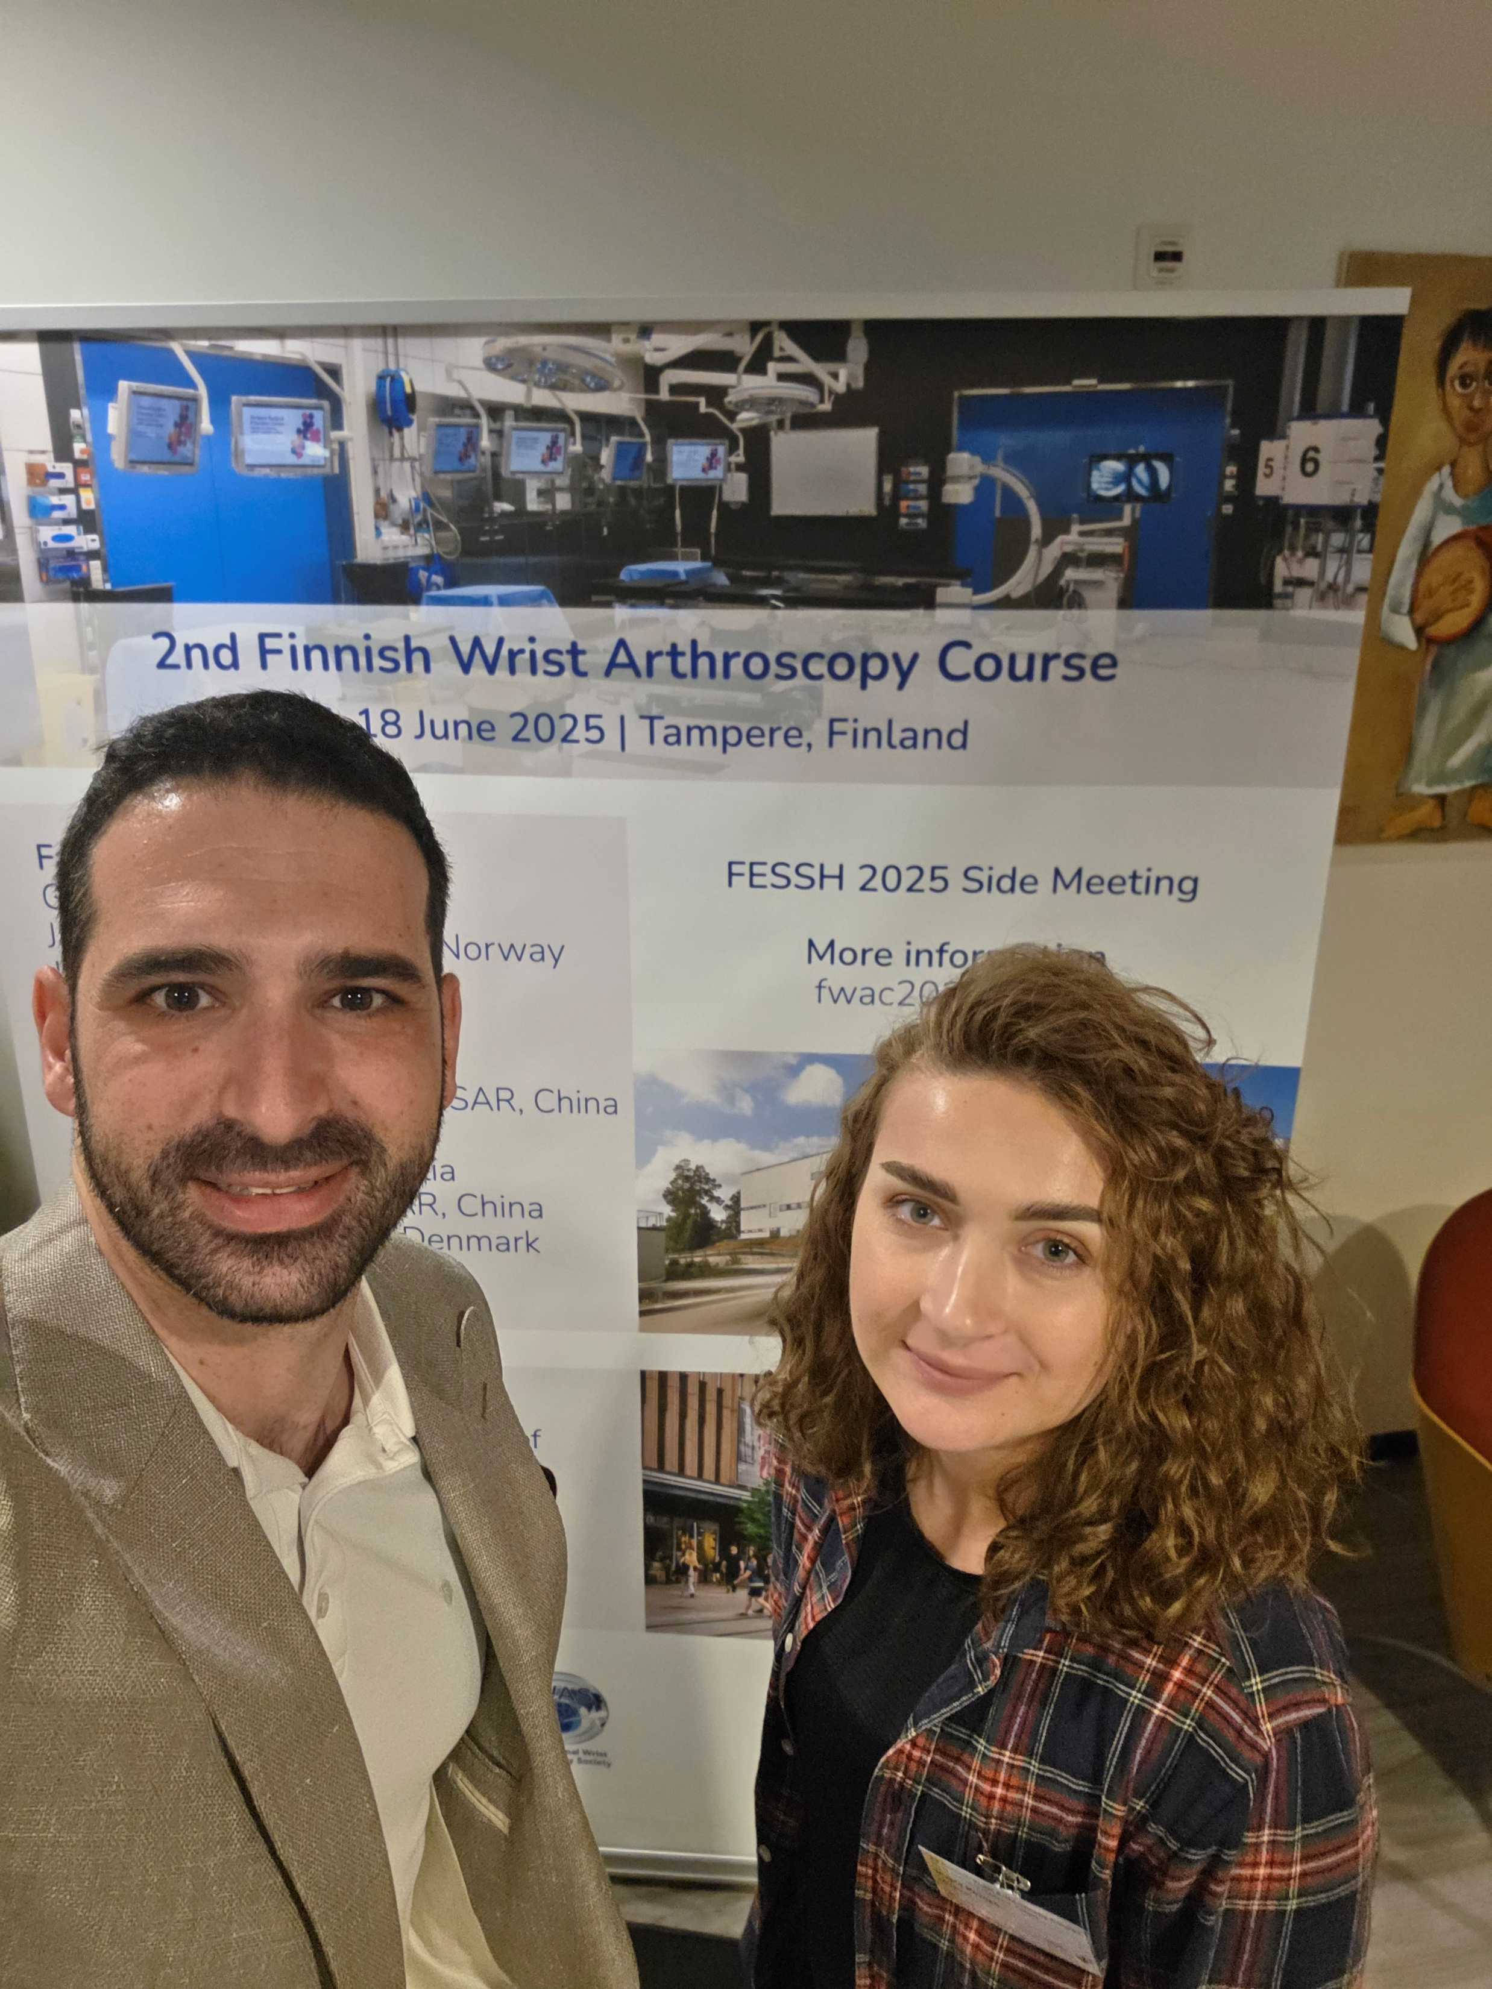
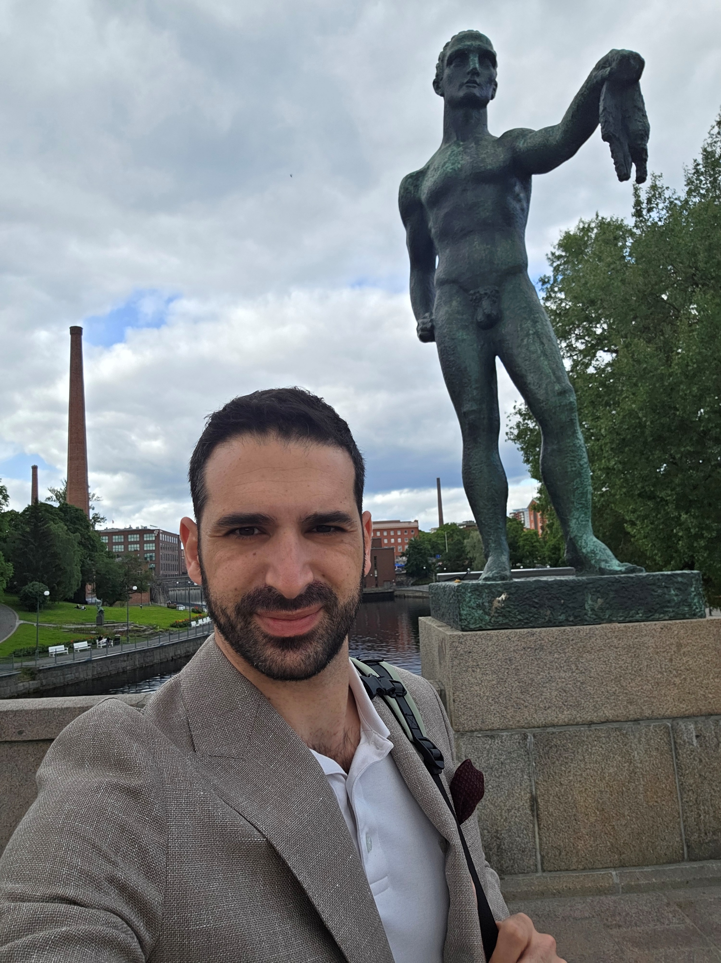
2nd Finnish Wrist Arthroscopy Course course

Slide 8
Social Activities

Slide 9
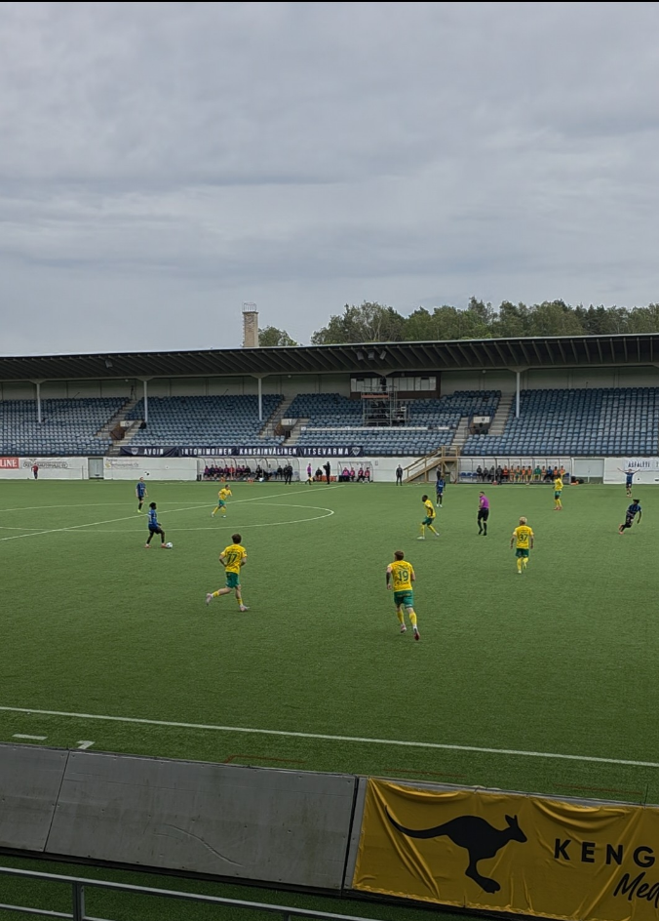
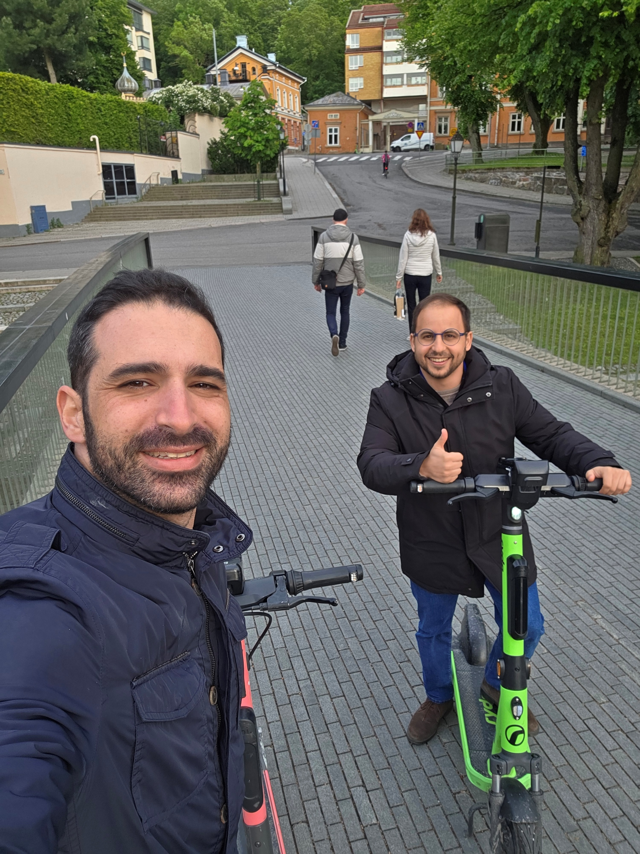
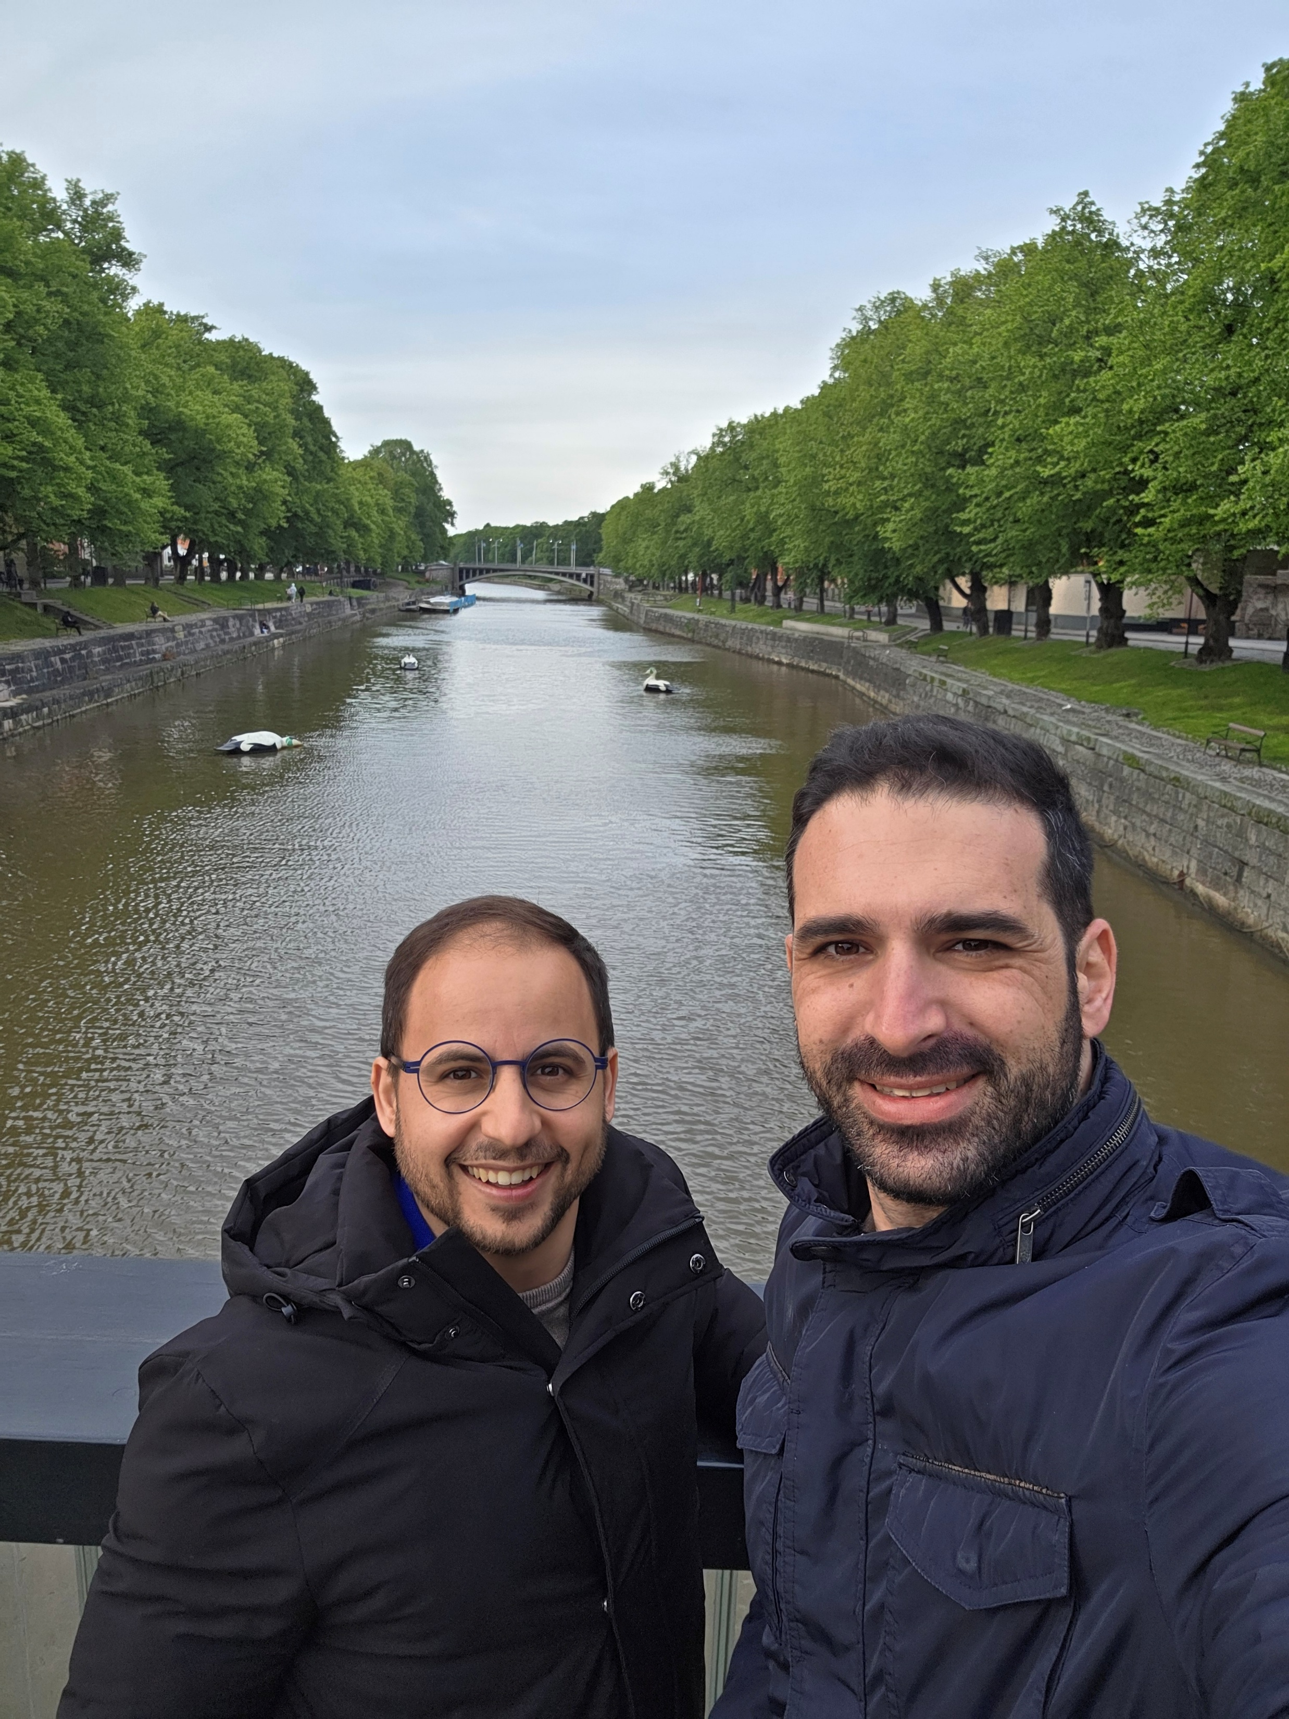
Turku

Slide 10
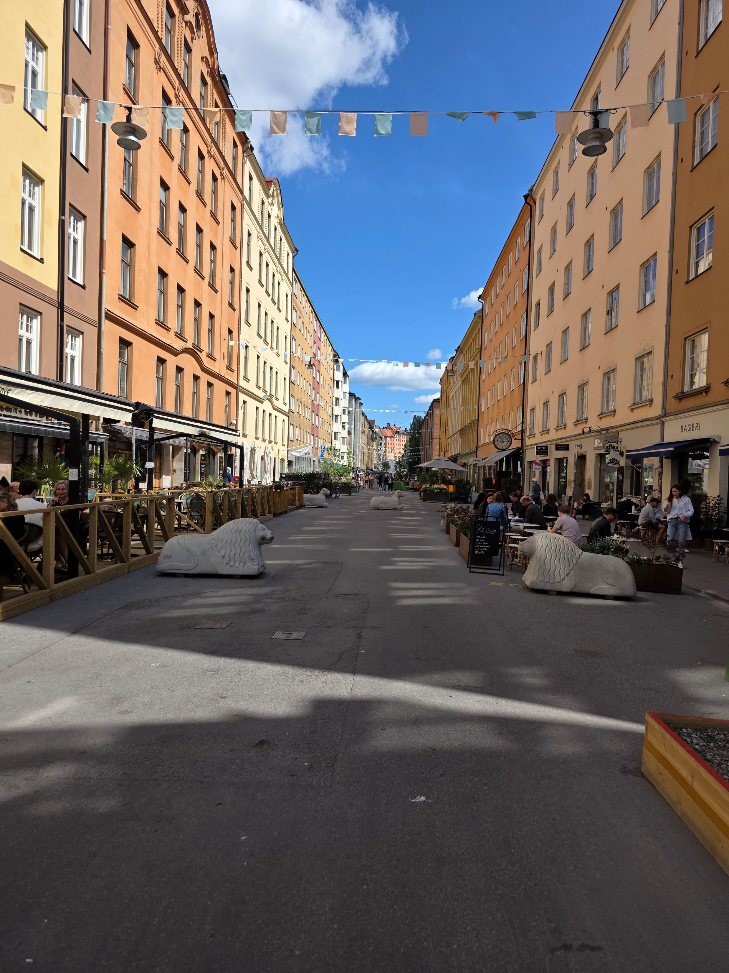
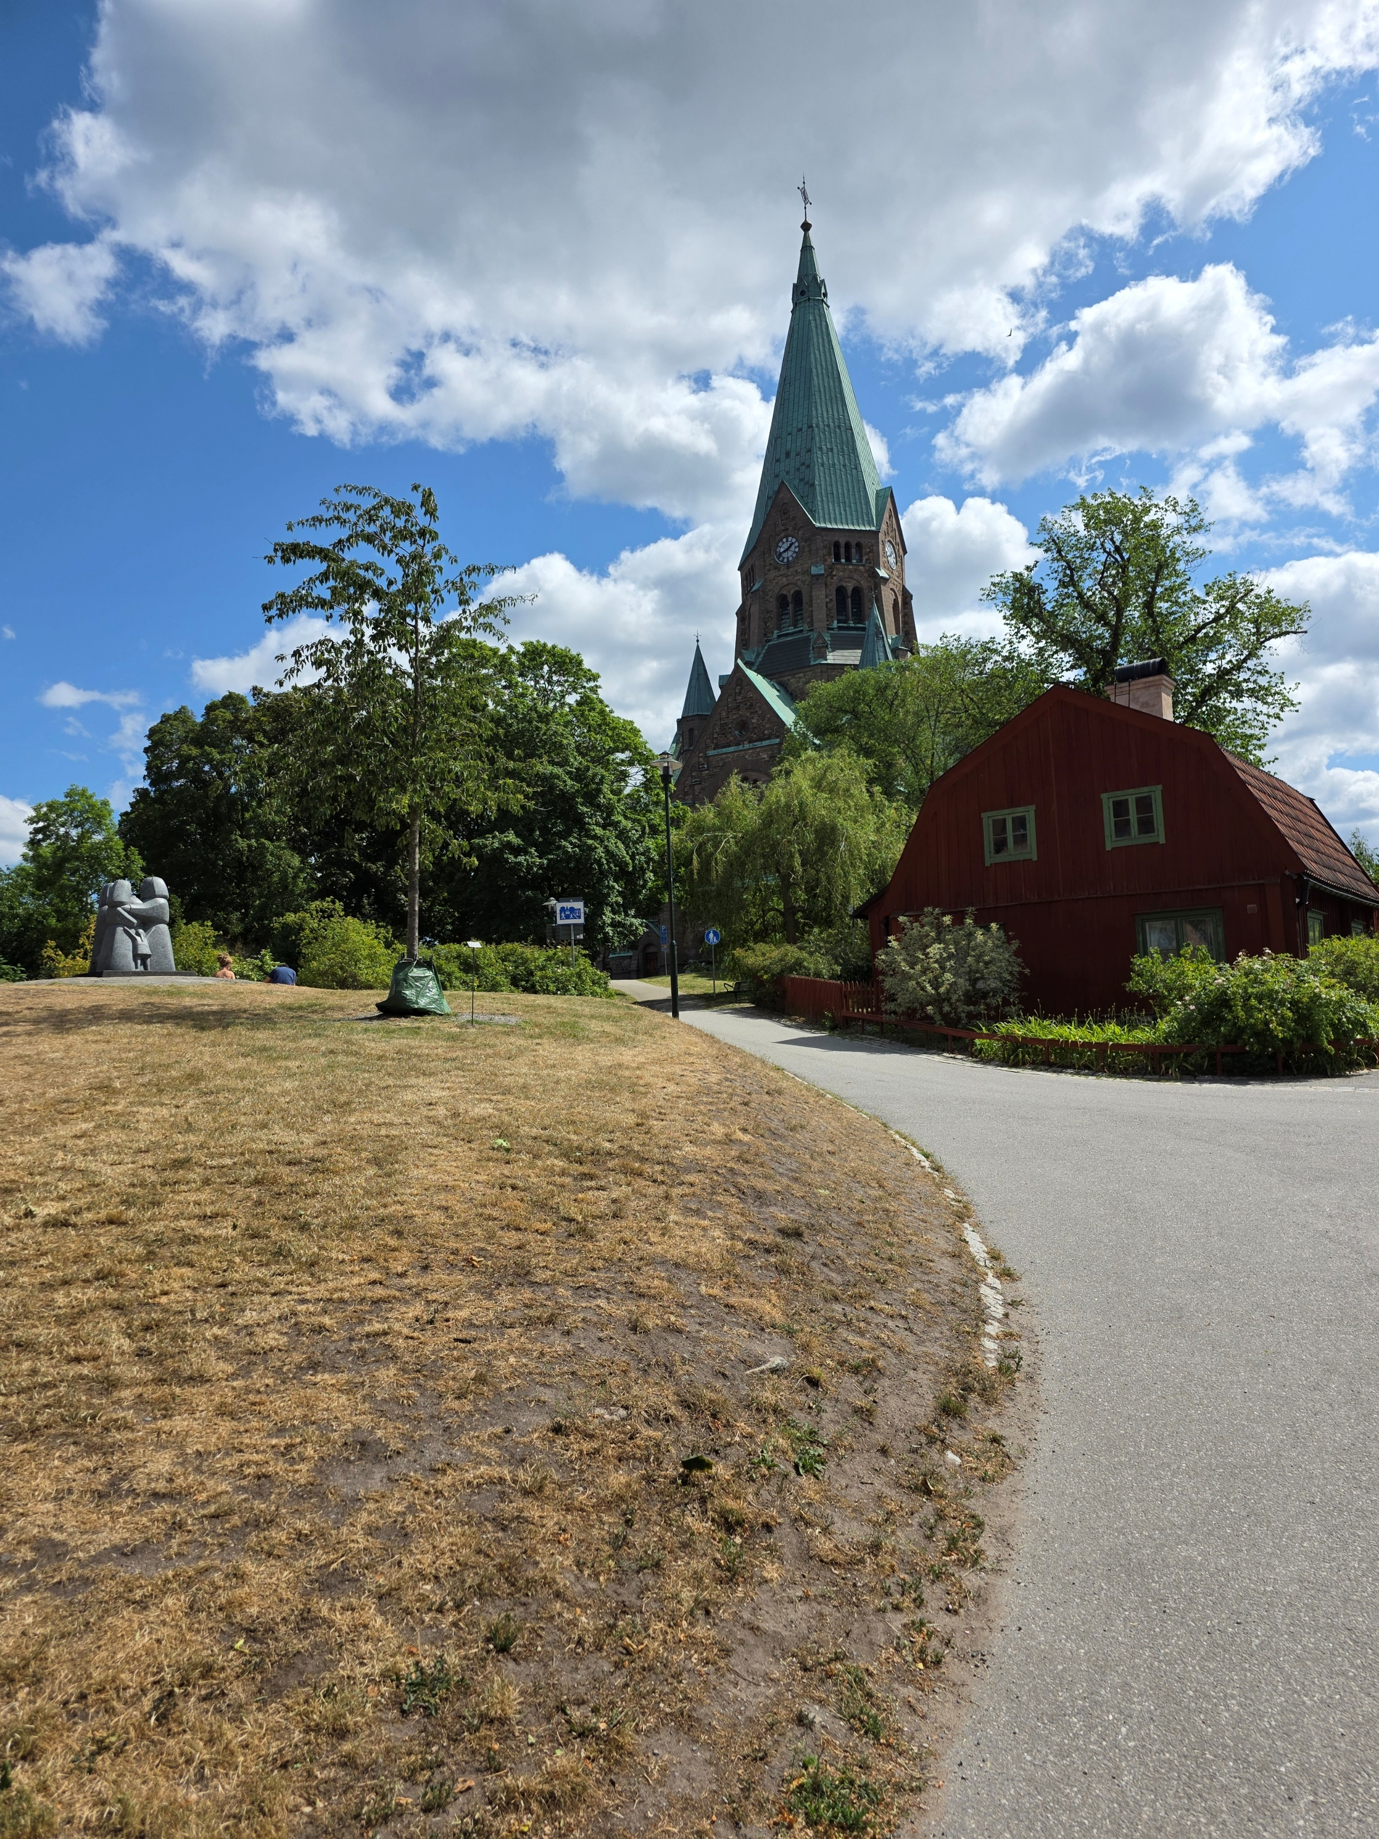
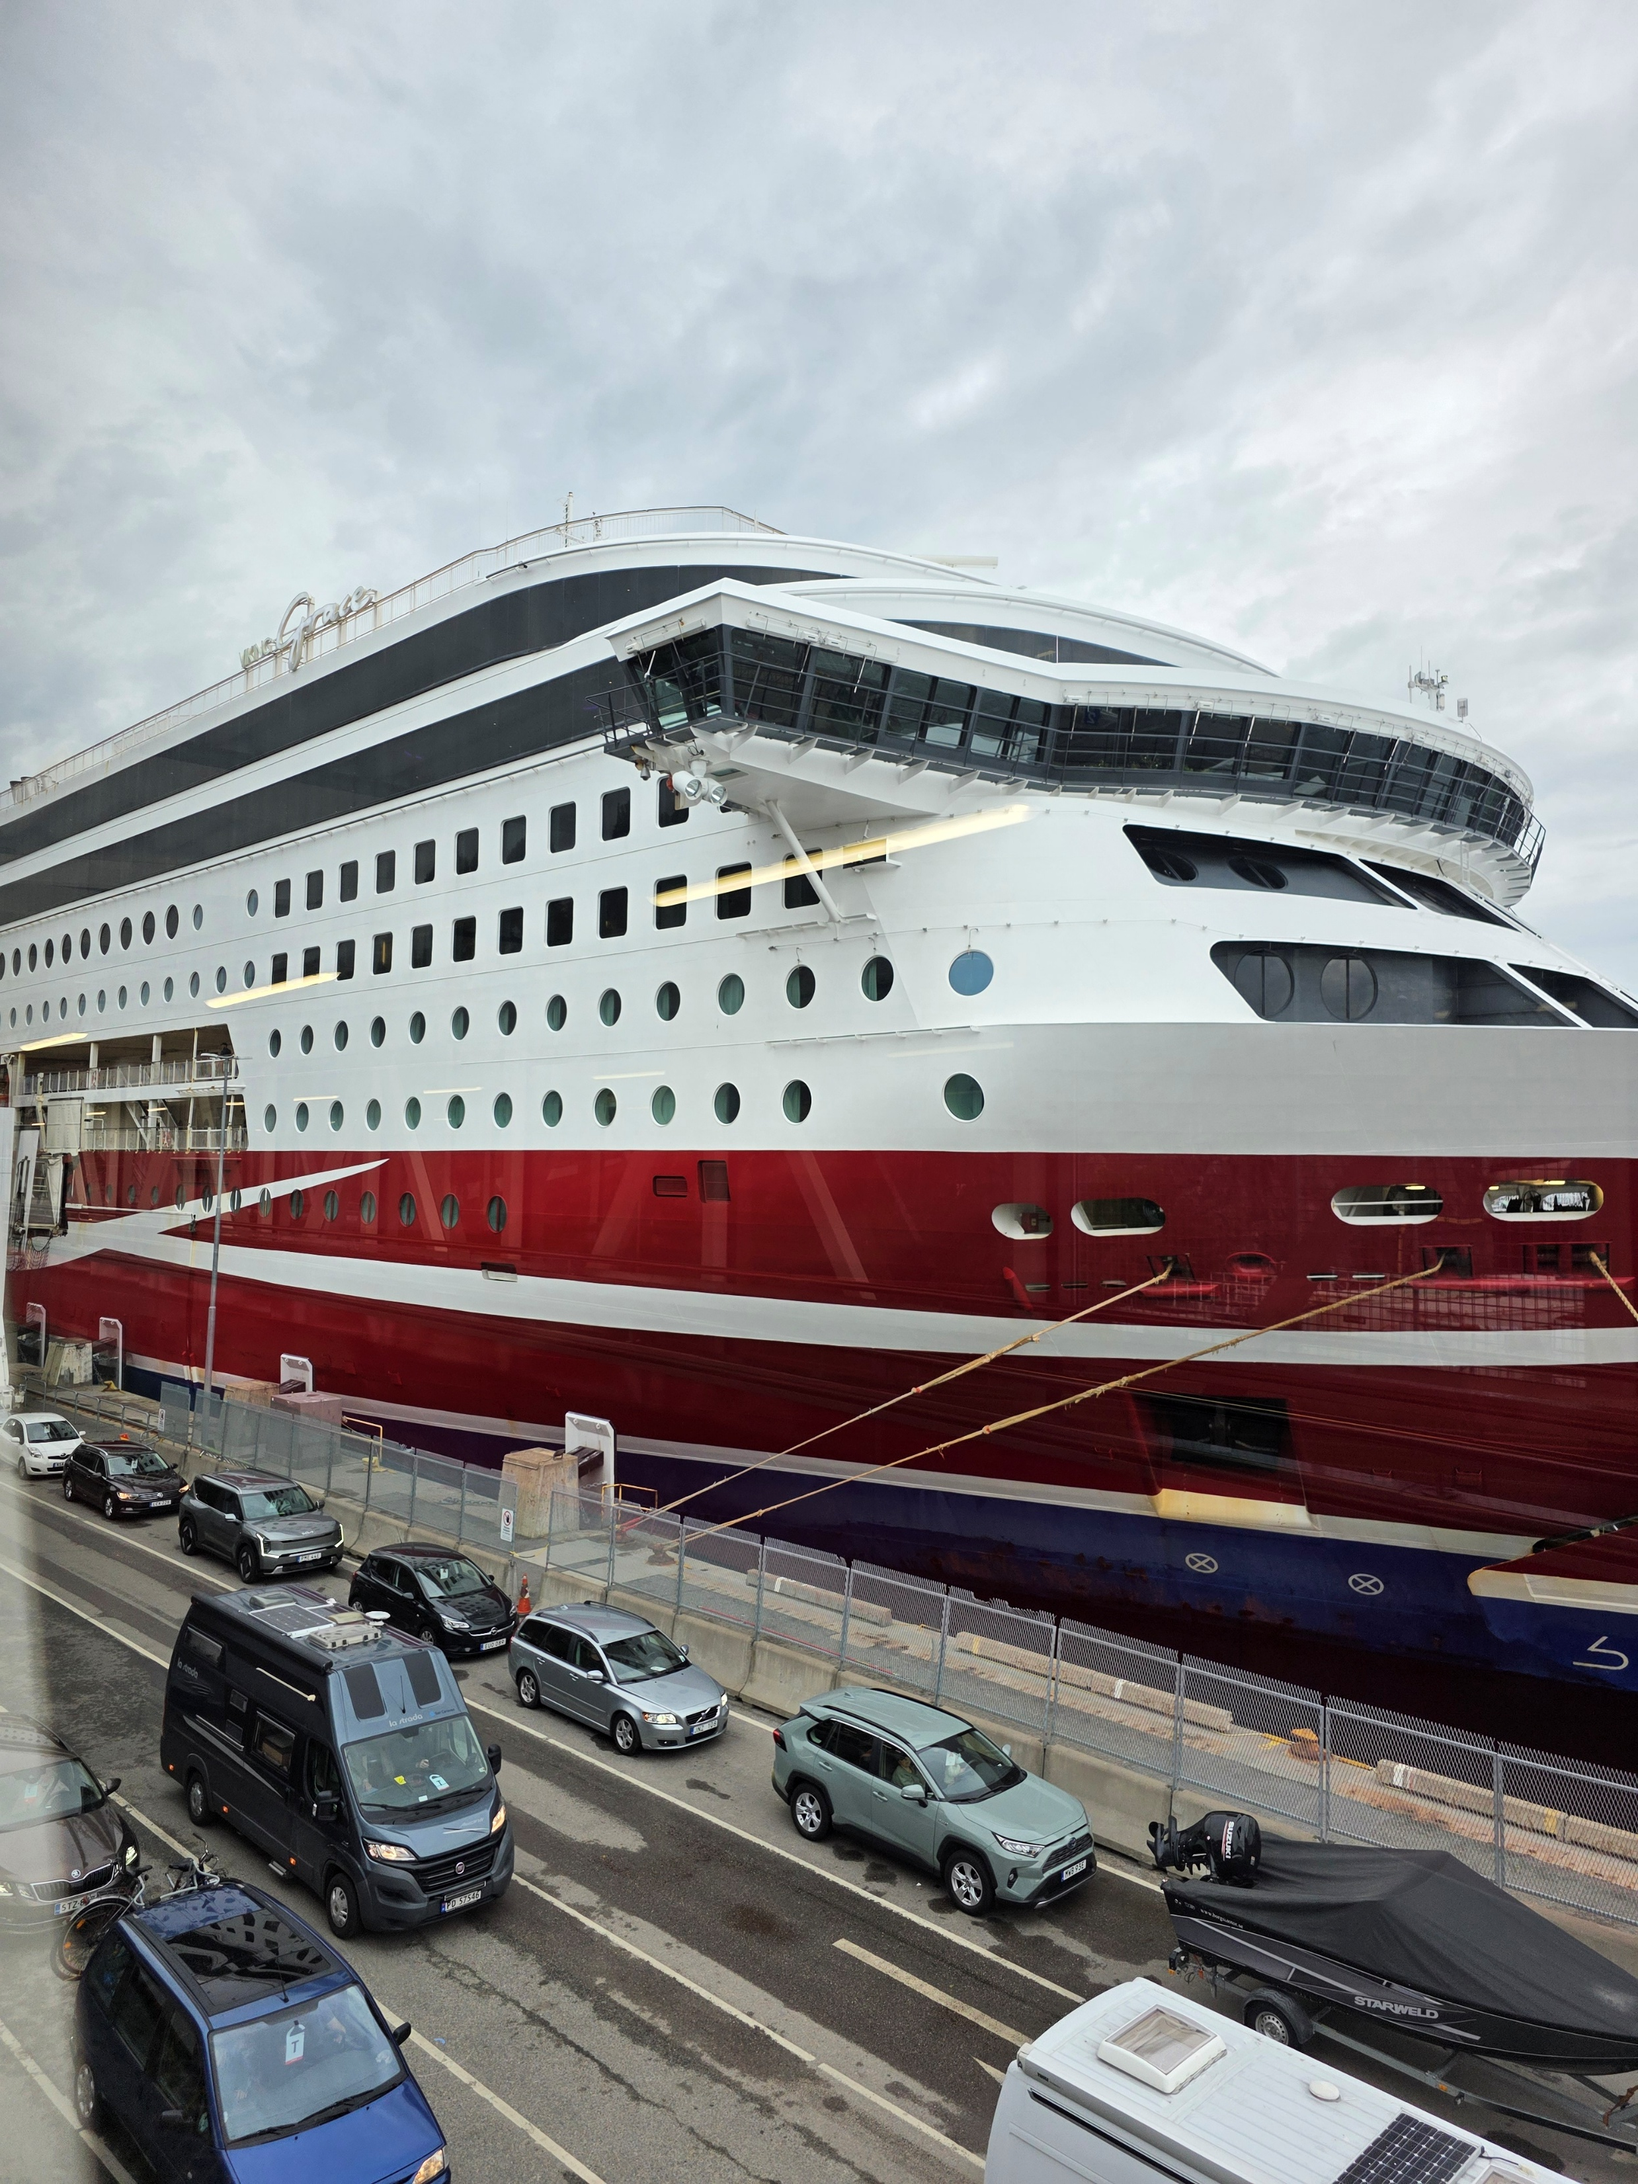
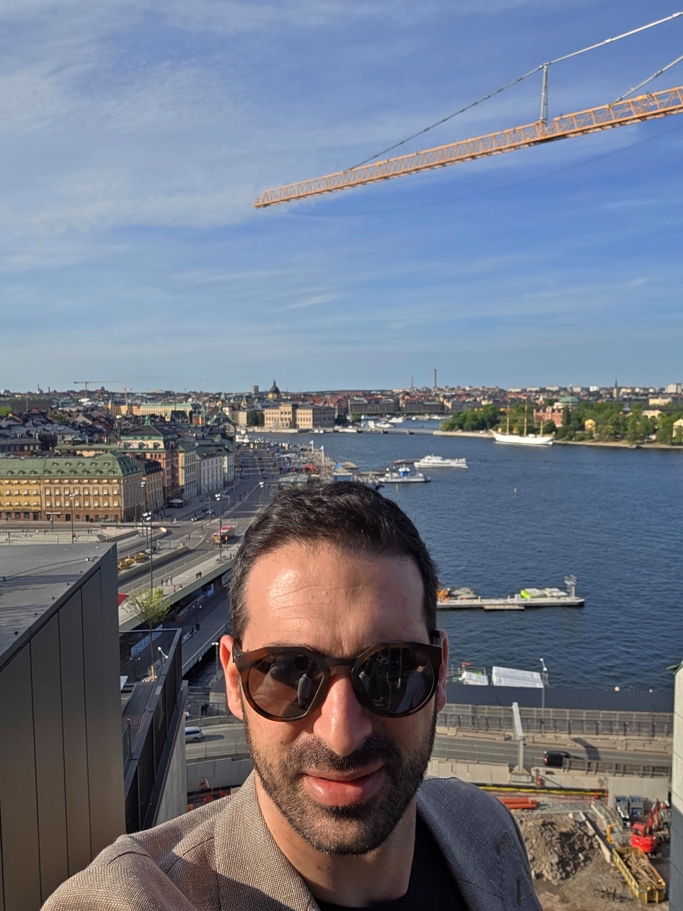
Stockholm

Slide 11
Thank you,

