Slide 1
FESSH Workshop 27 June 2024
The Step by Step Approach to a More Sustainable Practice

Slide 2
Agenda: here’s what you can expect from the next 30 minutes
The Step by Step Methodology and Impact: Feasibility Matrix.
Practical Example
Activity: Wrist Arthroscopy example
Tips for Sustainable Procurement
Wrap Up: Sharing the Free Resources to “Take Home” (virtually)

Slide 3

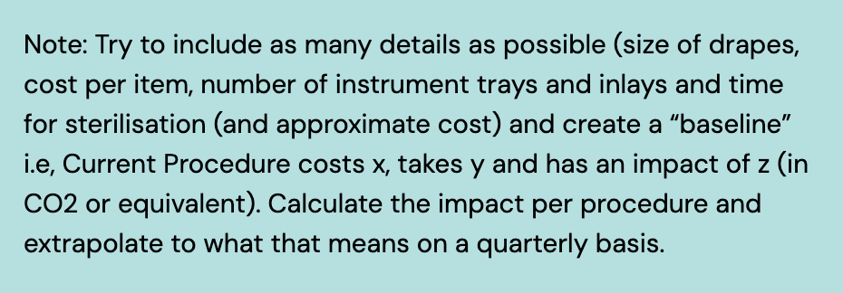
Step by Step: Supporting the Shift to more Sustainable Practice
Step 1: Choose a selection of the most resource-intensive procedures and map your current Way of Working (WoW)

Slide 4

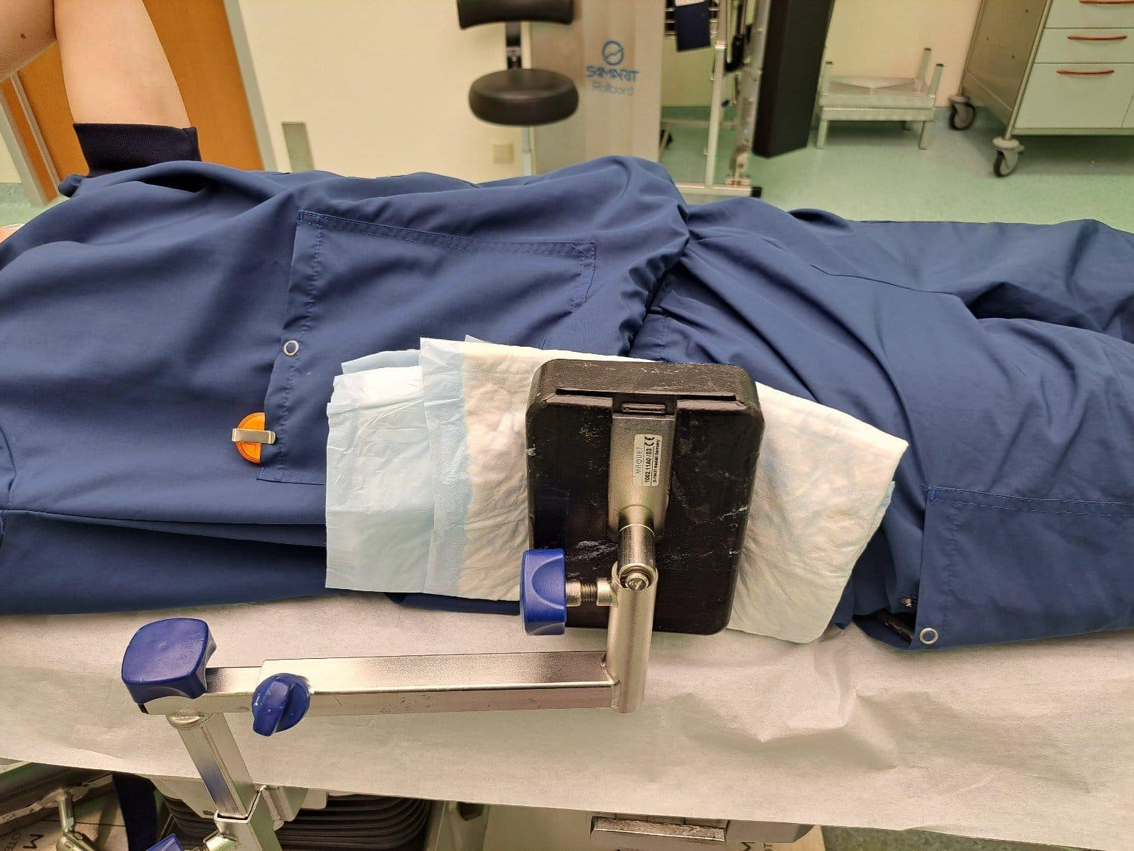
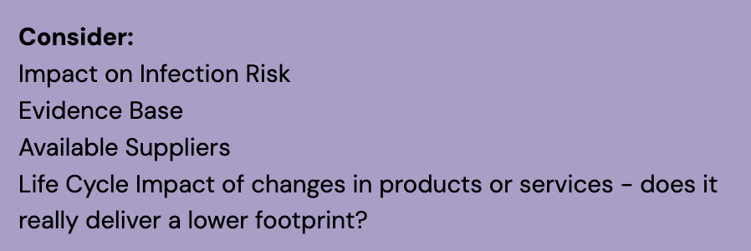
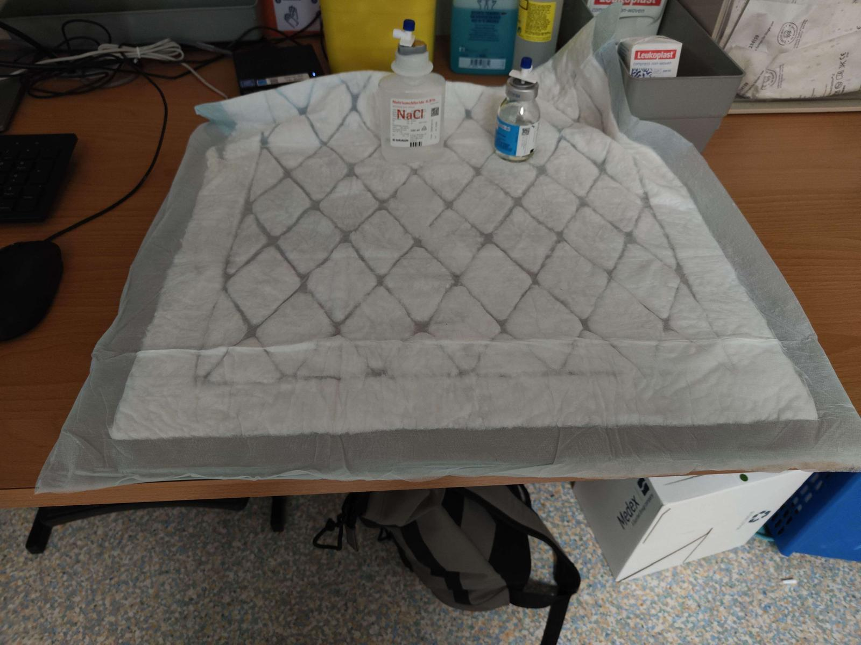
Step 2: Spend some time with a multidisciplinary team to determine your “Ideal”. For example with:
Sterilisation
Procurement
Assistants
Facilities
Anaesthesia and other surgeons

Slide 5
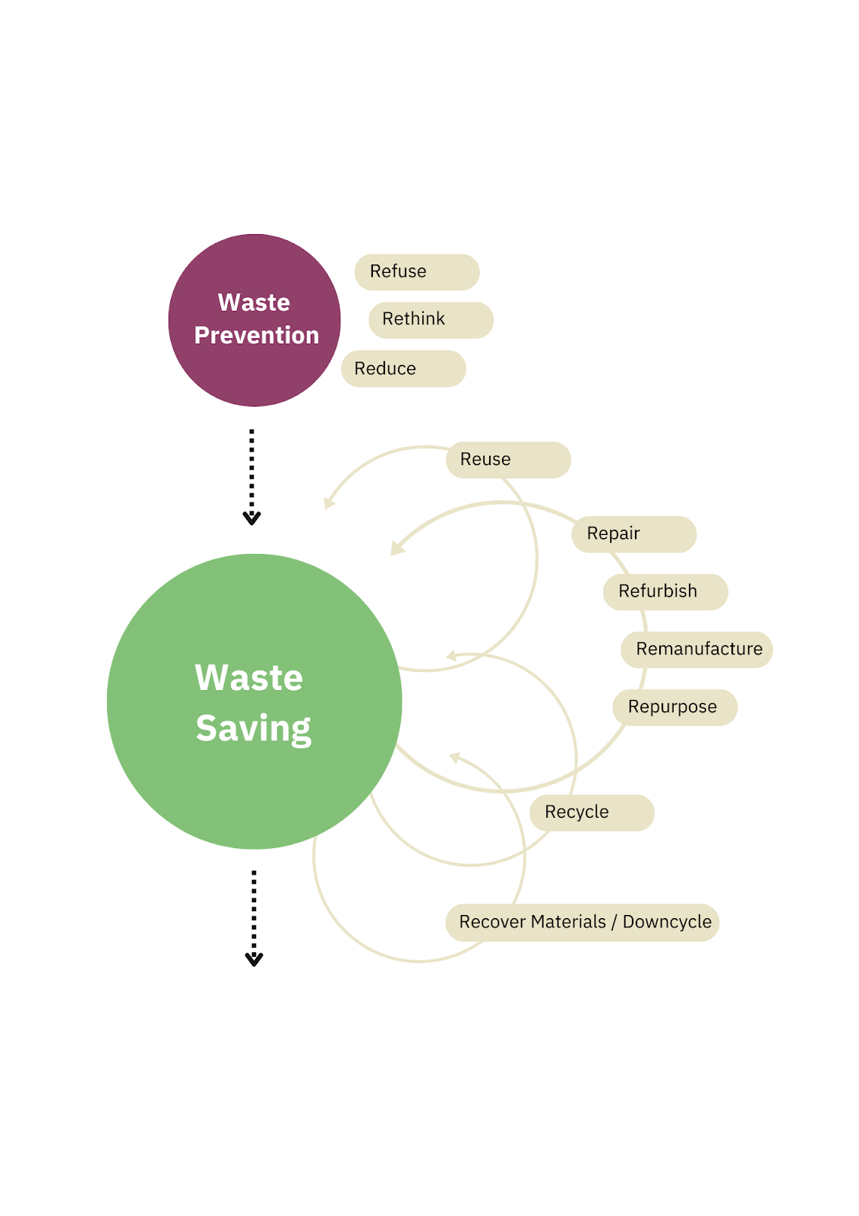
You can use the “R-Ladder” to help to identify opportunities.
Try to focus on R items higher up the ladder. The best approach to Waste is to avoid generating it to begin with

Slide 6


Step 3: For each potential action ask the question “What needs to be true for us to make this happen?” as this will help you to define the action
Step 4: Make your action plan concrete. Assign an accountable person and define in terms of “do what?, to what? by when”
Category | Current | Ideal (with evidence base) | Steps Required
Drapes | Disposable | Reusable
Instruments | Disposable | Reusable
Equipment | Air ventilation class 1 | Air ventilation class 2
Implants and Disposables | No implants Disposables see instruments/equipment/drapes
Anaesthesia and Medication (if applicable) | Inhalational anaesthesia | Intravenous or only local/locoregional anaesthesia
Waste | Medical waste, no waste separation | Less medical waste, separation of waste

Slide 7



Step 5: Ensure a clear plan to “educate” the team about the planned changes - the benefit and the “bigger picture” of why it’s important and the contribution that they can make
Step 6: Make the Change. Faith. Focus. Finish.
Step 7: Collect data on the revised Protocol (as per Step 1) including feedback from users on any challenges they face. Compare the Post-Implementation measurement to the initial baseline measurement to calculate the impact.

Slide 8
Solar panels and automatic lights
Refurbished equipment and furniture
Employees
Refurbished building and interior
Relationship with General Practitioners
Waste separation and recycling
Sustainable working climate
Compostable absorption material
Sustainable practice
Electric car charging facilities
Operating room
Washable surgical cap
One stop shop
Ventilation system
Sustainable outpatient services
Hand therapy
Video consulting services
Reuse suture removal materials
Minimizing paper use
Compostable splint material

Slide 9


Used with permission from
high
Determining your focus using the impact: feasibility matrix
low
2
1
high
impact
4
3
How does it contribute to CO2 reduction / policy?
1
Beginning Green Team
low
2
Beginning Green Team
3
Advanced Green Team
feasibility
Don’t start
Can I carry it out with the Green Team, or do I need extra people and/or money?
4

Slide 10
To make it last, make it context-specific

Slide 11
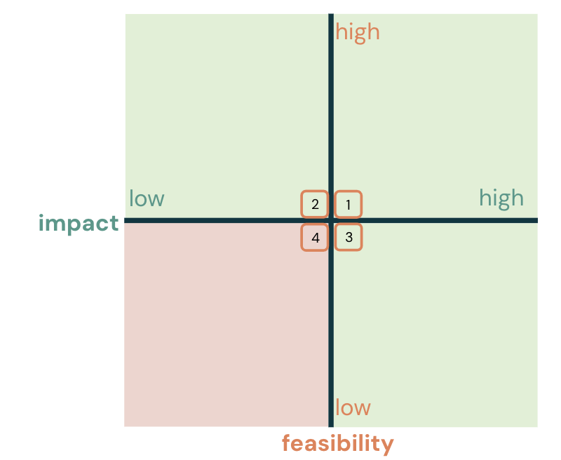
Work on your own or in a group to complete this exercise for wrist arthroscopy (15 mins)
1: Use the impact matrix to plot each of the actions in the “ideal column”
Category | Current | Ideal (with evidence base) | Impact: Feasibility | Steps Required
Drapes & Clothing | Disposable | Reusable
Instruments | Disposable | Reusable
Equipment | Air ventilation class 1 | Air ventilation class 2
Implants and Disposables | No implants Disposables see instruments/equipment/drapes
Anaesthesia and Medication (if applicable) | Inhalational anaesthesia | Intravenous or only local/locoregional anaesthesia
Duration of procedure (in minutes) | 30 | 30
Waste | Medical waste, no waste separation | Less medical waste, separation of waste
2: List the steps that would be required to accomplish the quadrant 1 items

Slide 12
Define consistent and verifiable evaluation criteria for environmental and social aspects with an appropriate weighting
Proactively post in your network to increase pool of suppliers
Consider all aspects that reduce the environmental footprint: optimised logistics, bulk sterile, lean instrument sets, reusable trays, remote support
Agree a multi-year joint improvement plan with suppliers: include reciprocal commitments and set contract conditions to ensure performance
Ensure preventative maintenance and repair included in contracts
Request LCA data prepared according to relevant ISO standards
Ensure that your methods of cost-calculation consider aspects like energy saved, reduced waste costs
Tips for Sustainable Procurement

Slide 13


Scan the QR-code for direct access here:
This course was created in collaboration with

Slide 14
References
Air Ventilation:
Traversari AA, Bottenheft C, van Heumen SP, Goedhart CA, Vos MC. Effect of switching off unidirectional downflow systems of operating theaters during prolonged inactivity on the period before the operating theater can safely be used. Am J Infect Control. 2017 Feb 1;45(2):139-144. doi: 10.1016/j.ajic.2016.07.019. Epub 2016 Oct 11. PMID: 27742147.
MacNeill AJ, Lillywhite R, Brown CJ. The impact of surgery on global climate: a carbon footprinting study of operating theatres in three health systems. Lancet Planet Health. 2017 Dec;1(9):e381-e388.
Luchtbehandeling - Richtlijn - Richtlijnendatabase
Instruments:
Siu J, Hill AG, MacCormick AD. Systematic review of reusable versus disposable laparoscopic instruments: costs and safety. ANZ J Surg. 2017 Jan;87(1-2):28-33. doi: 10.1111/ans.13856. Epub 2016 Nov 23. PMID: 27878921.
Equipment:
Startpagina - Luchtbehandeling in operatiekamers en behandelkamers - Richtlijn - Richtlijnendatabase (unfortunately in Dutch)
Further Reading:
10 concrete steps to make your OR more sustainable · Incision

